Slide 1


Slide 2

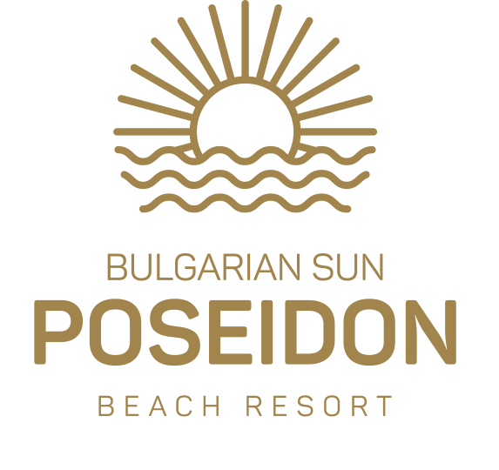

BULGARIAN SUN HOTELS is a Bulgarian hotel chain, managing two four-star hotels and a luxury five-star hotel in Golden Sands, Bulgaria.
Apollo Spa Resort 4 * +, Helios Spa Hotel 4 * and the newest unique Poseidon Beach Resort 5 * are well known for their high standards, high quality service and the desire to make guests feel at home. That is why our motto is "Your Second Home", because the satisfaction of our guests is our first priority.

Slide 3
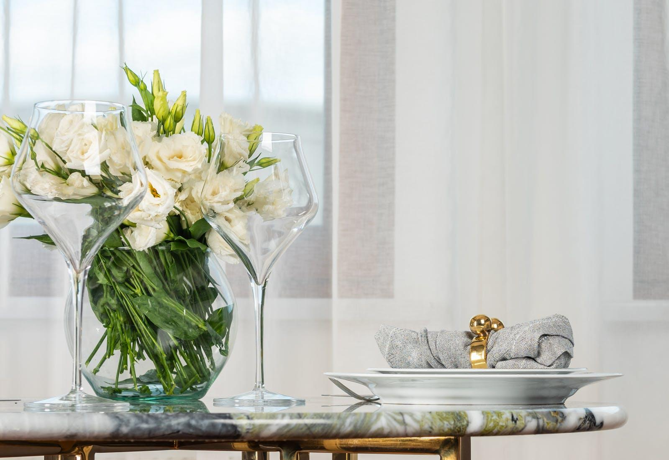
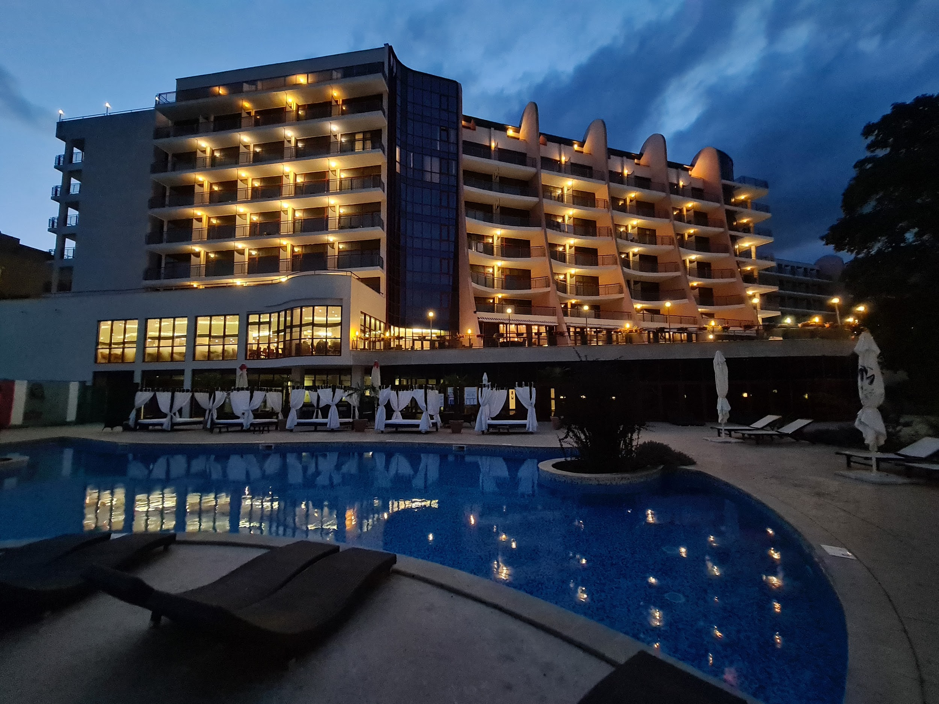
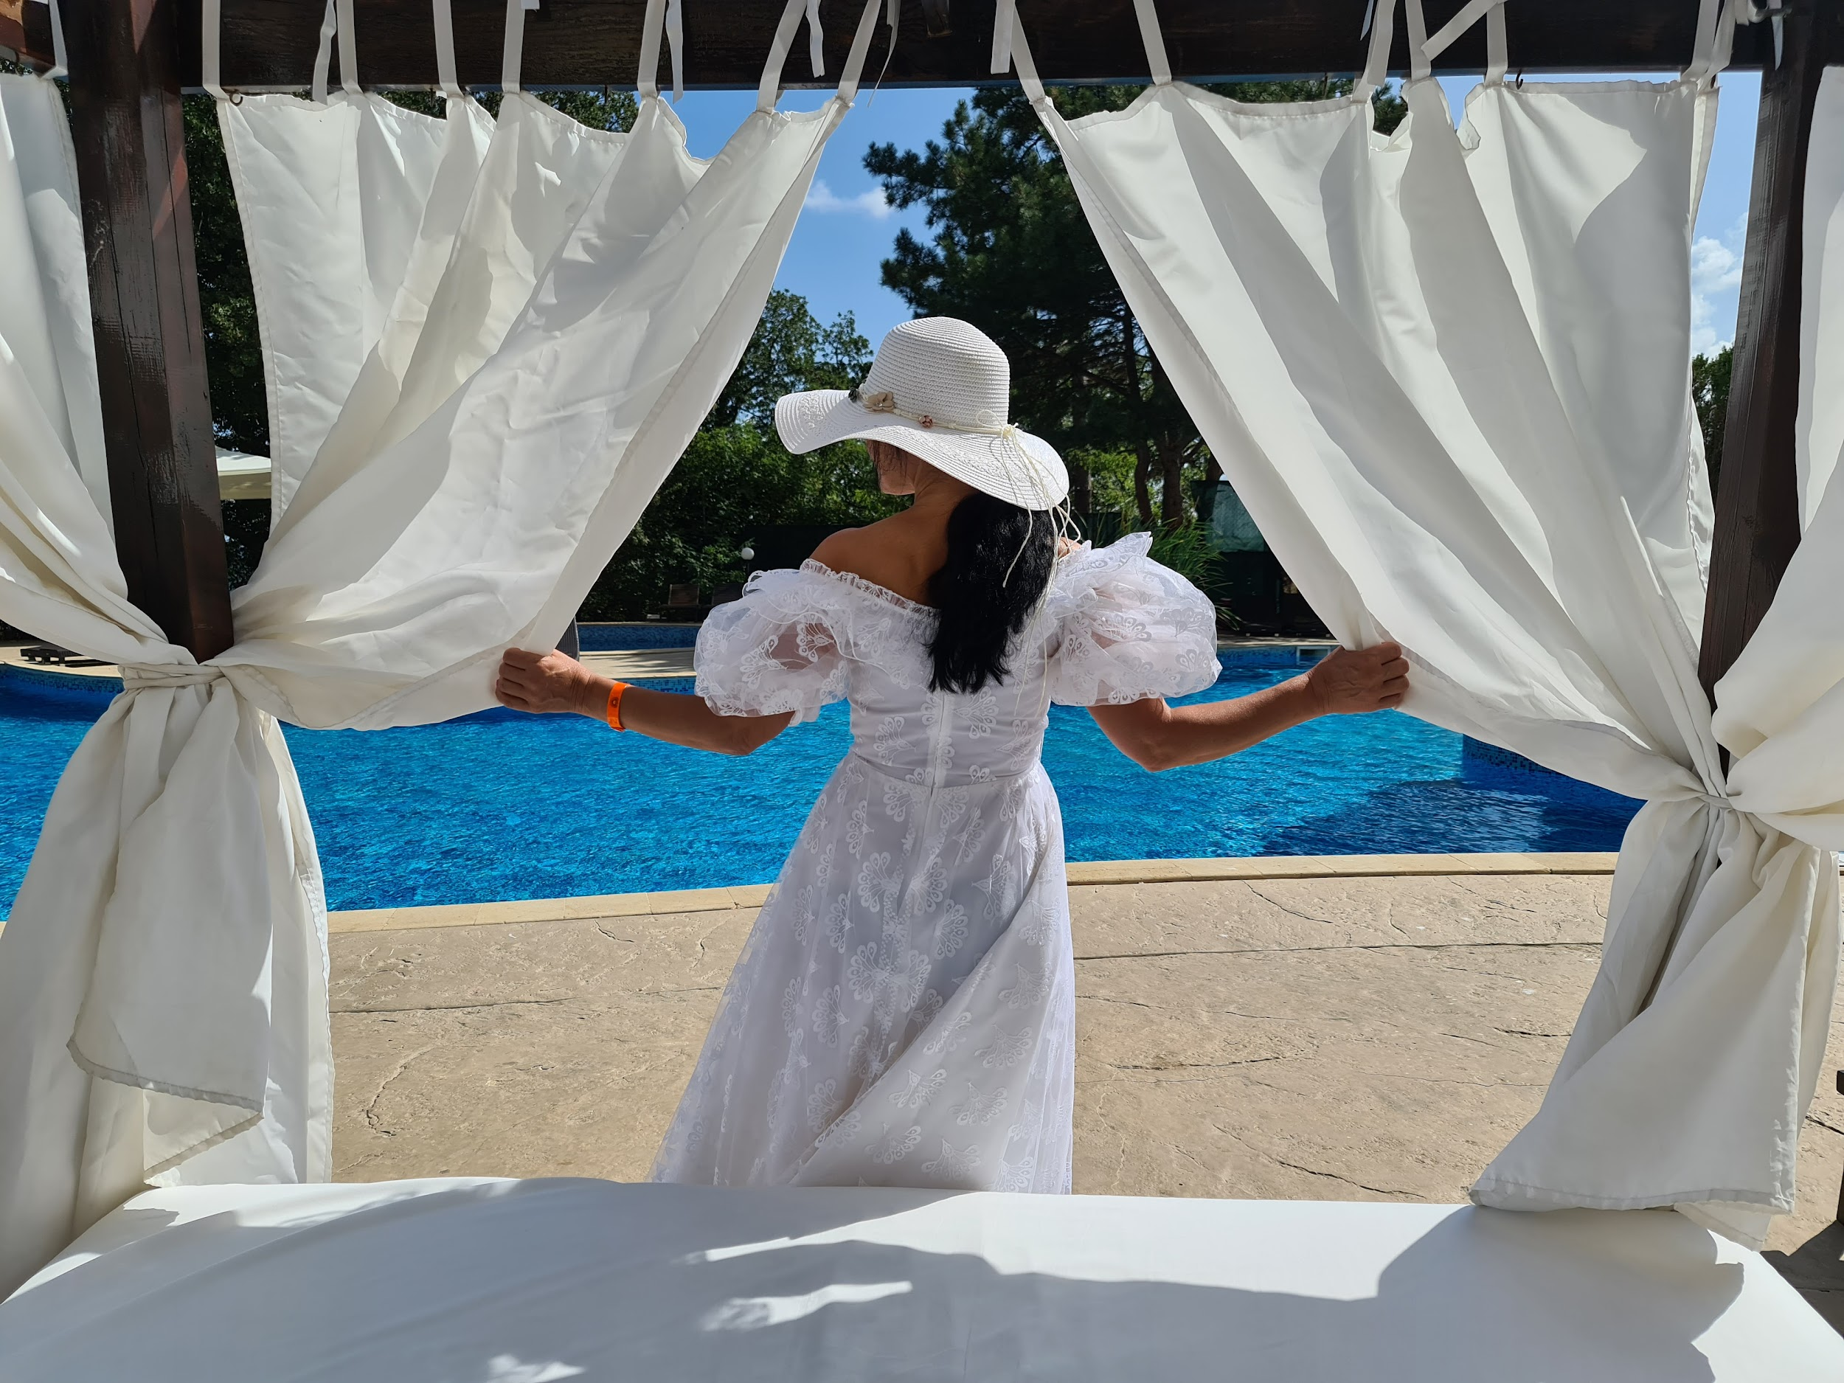
Apollo Spa Resort ****+ Ultra All Inclusive
Located in the Golden Sands Nature Park, overlooking the Black Sea coast, Apollo Spa Resort **** + is located just 30 minutes from Varna International Airport and combines the beauty and tranquility of the ancient forest and the breathtaking scenery of the Black Sea.
Apollo Spa Resort **** + has a variety of rooms that meet the needs of each guest - from individual trips to vacations for the whole family. The hotel has 196 modernly furnished rooms and suites, which provide their guests with an incredible view of the unique beach on the Black Sea coast, as well as the beautiful forests of the Golden Sands Nature Park.

Slide 4
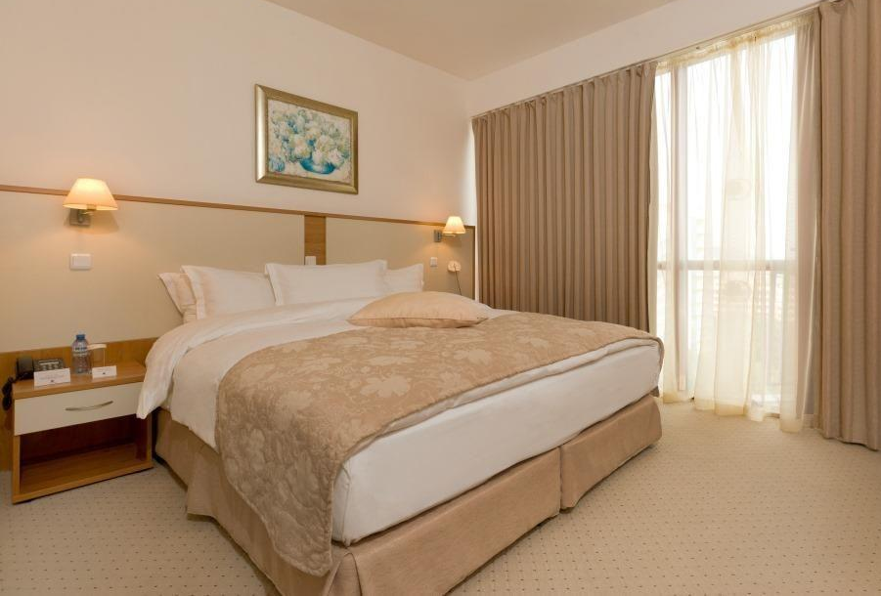
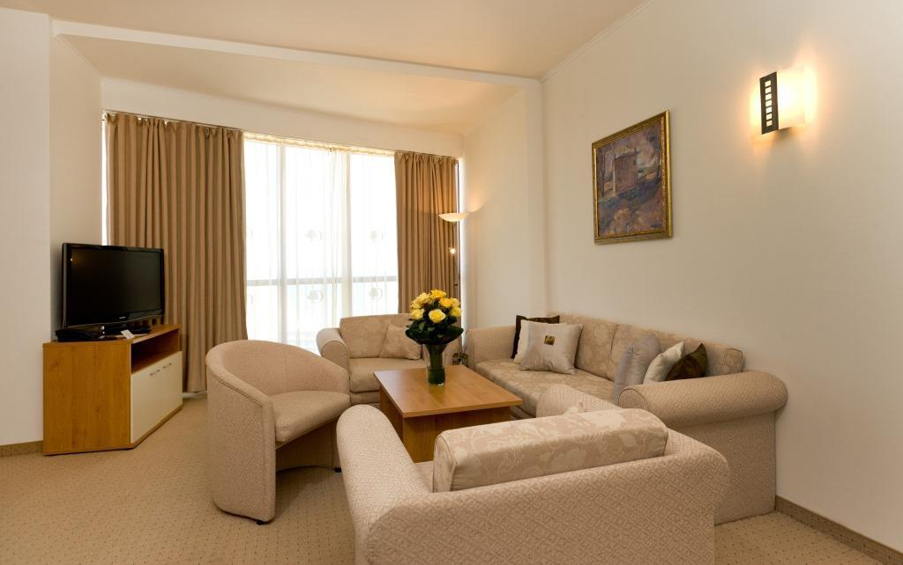
All rooms in Apollo Spa Resort **** + have comfortable work areas, flat screen LCD TV, private terrace with stunning views, Sweet Dreams beds, high speed internet, central air conditioning, iron and ironing board, safe, cooking service of tea and coffee, radio alarm clock with MP3 outlet, telephone with voicemail and data transfer, as well as mini bar.
At the disposal of the hotel guests are indoor and two outdoor pools, one of which with water-slides for the youngest guests , multifunctional tennis and volleyball court with prior request, daily sports program, fitness center, sauna and steam bath.
For our youngest guests we have provided also a kids club, playground and animation.

Slide 5
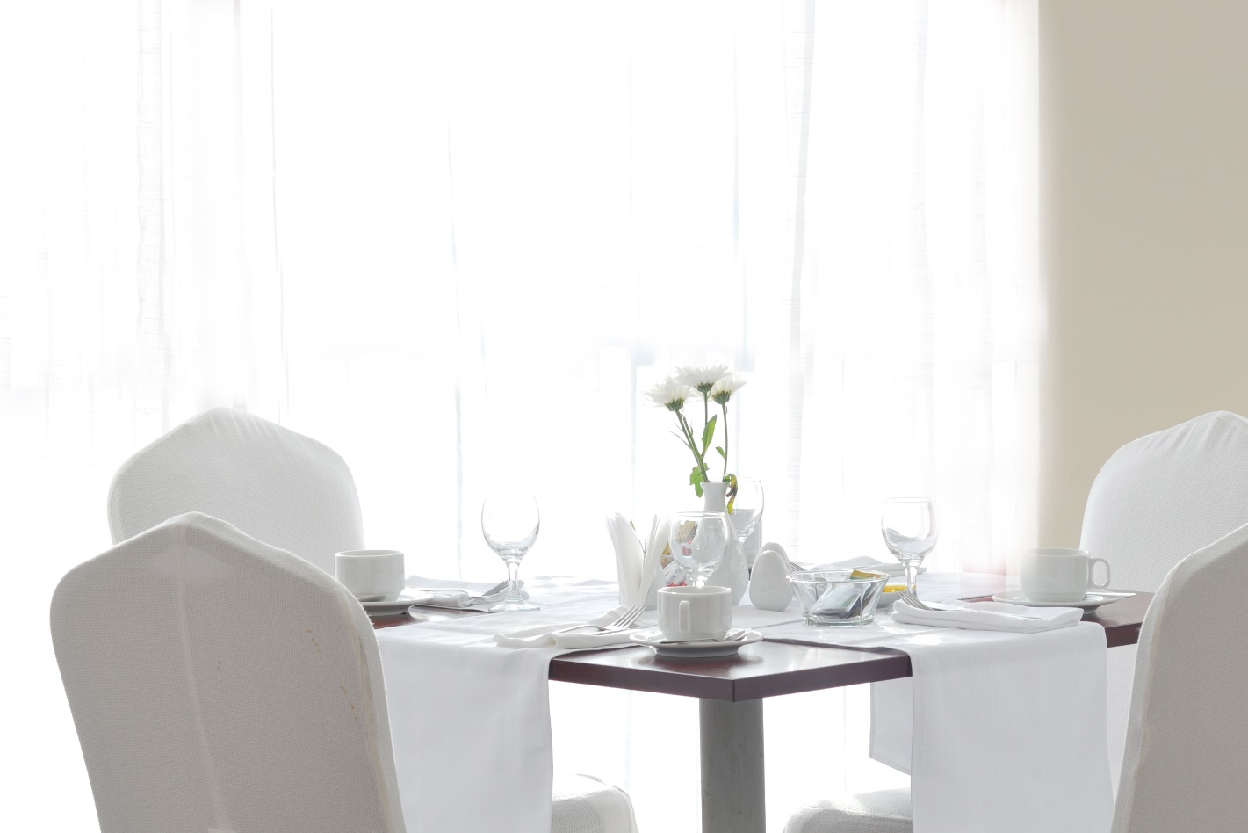
The modern Demeter Restaurant is open for guests throughout the day, offering a wide variety of freshly prepared dishes from traditional Bulgarian and international cuisine in a modern setting, daily live cooking and entertainment.
Demeter Restaurant serves breakfast, lunch and dinner buffets. We have equipment for preparing baby food. There is also a beautiful outdoor terrace, a lobby bar, a pool bar, and the Apollo nightclub - an ideal venue for corporate events, social dinners and private celebrations. Meals available at the hotel are based on Ultra All Inclusive

Slide 6
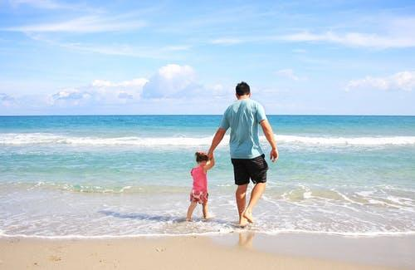
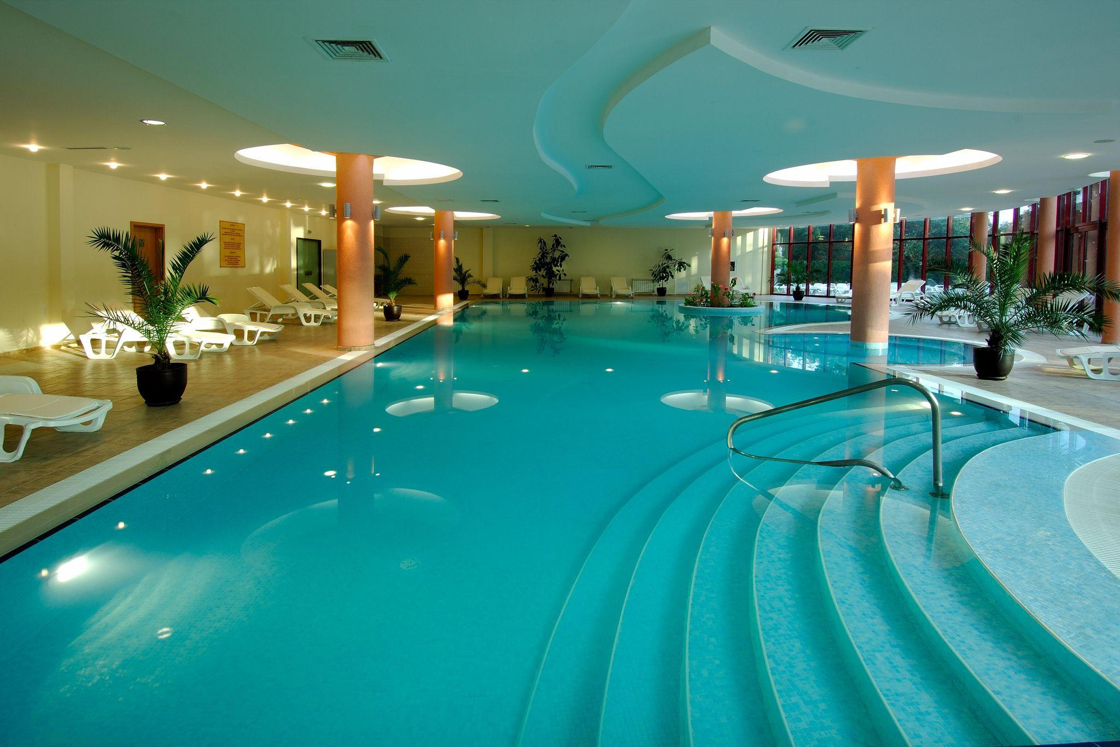
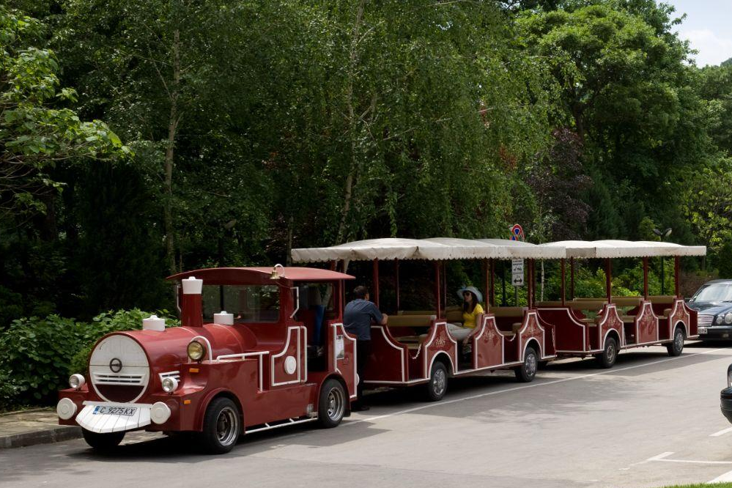
The hotel is close to the famous landmarks such as the center of Golden Sands and the Aladzha Monastery, the Aquamania Water Park, located 12km away at Albena. The hotel is located just 450 meters away from the beach, and all hotel guests can enjoy a mini-train ride to Riviera Beach. The nearest airport is Varna Airport, 18 km from the property.
With a beautiful view of the Black Sea, immersed in the tranquility of the beautiful nature park, Apollo Spa Resort remains true to the spirit of Bulgarian hospitality.

Slide 7

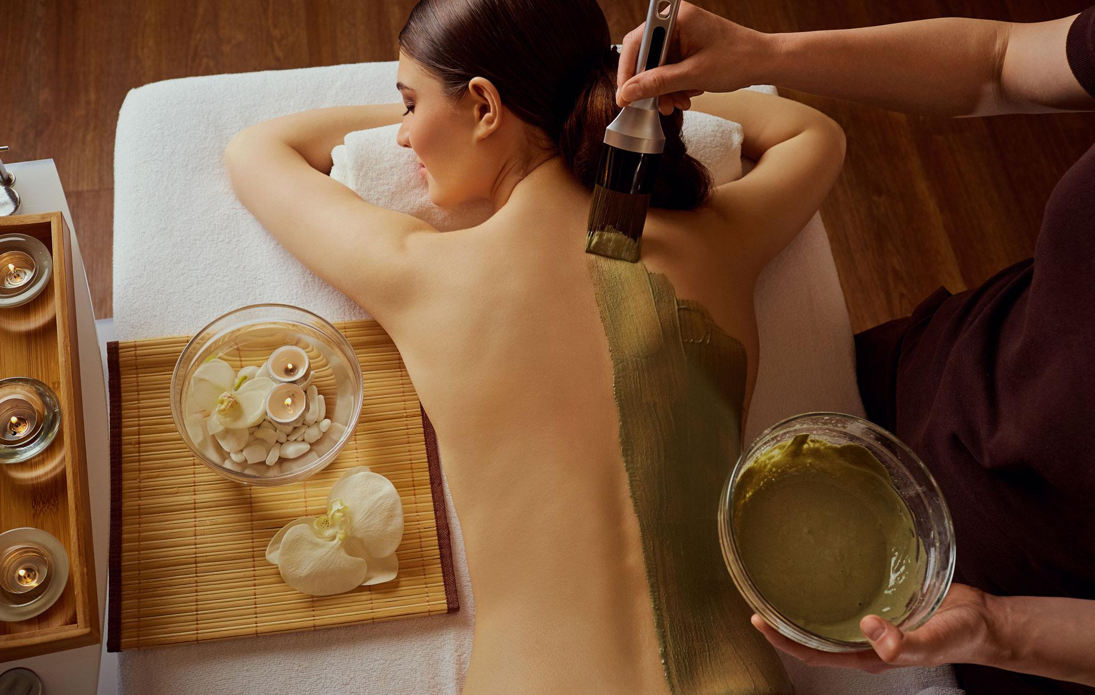
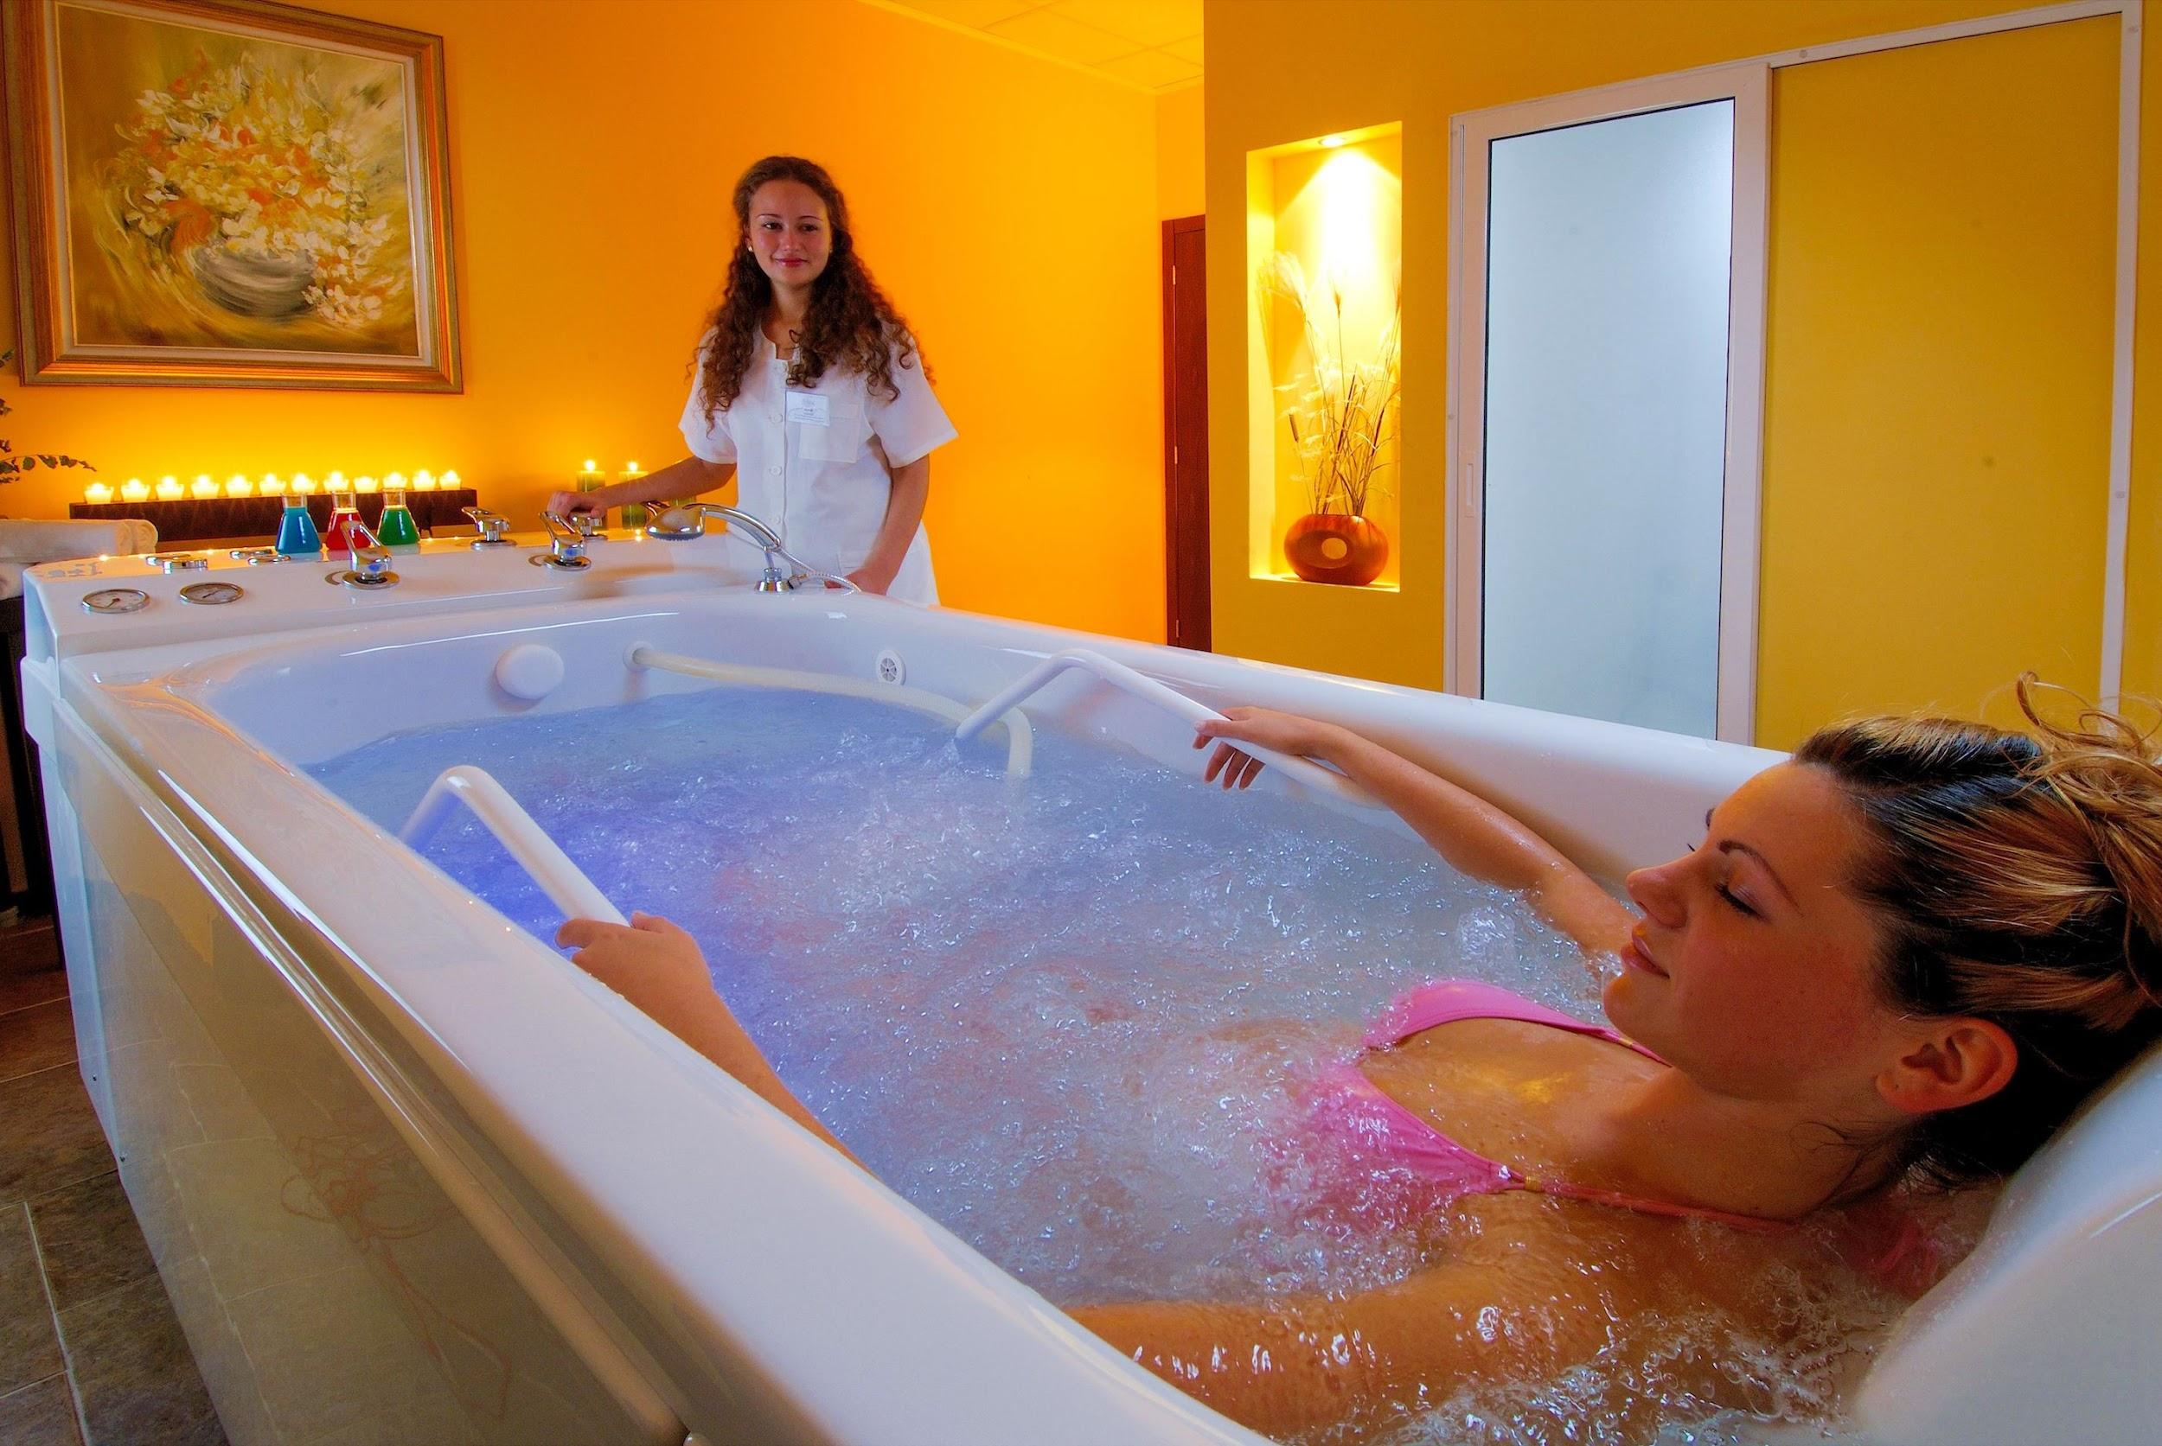
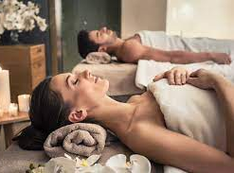
Aphrodite Beauty Spa & Health Clinic
Aphrodite Beauty Spa & Health Clinic is located in Apollo Spa Resort **** + - one of the largest, sophisticated and professional spa and wellness centers in Bulgaria, which, among other things, has a medical license. This unique spa center for rejuvenation and recovery occupies an area of 2300 square meters, where there are 35 luxurious offices, equipped with a special light and sound system and the most modern equipment for individual procedures such as facial and body massage, aesthetic and therapeutic procedures.

Slide 8
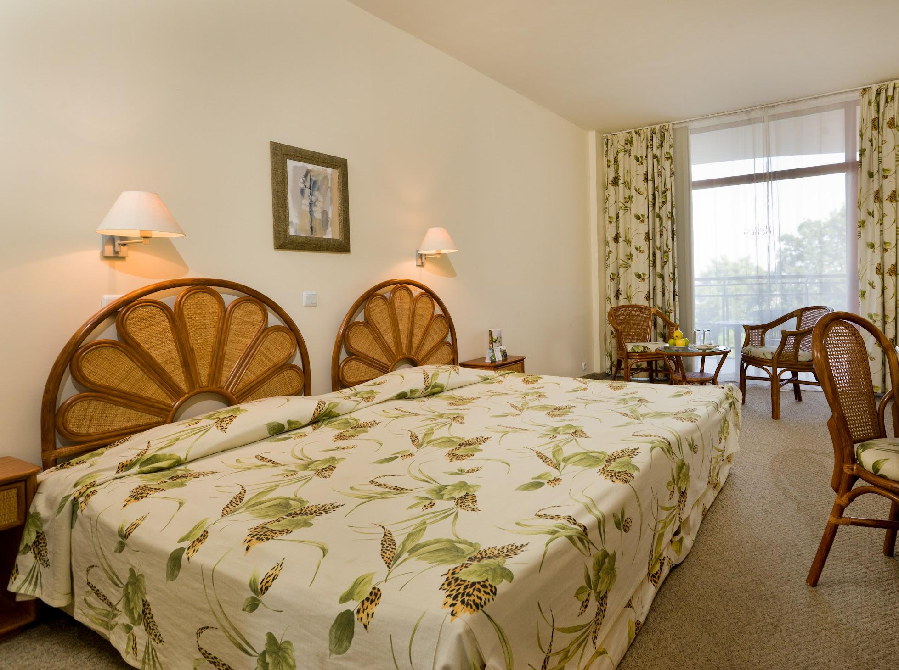
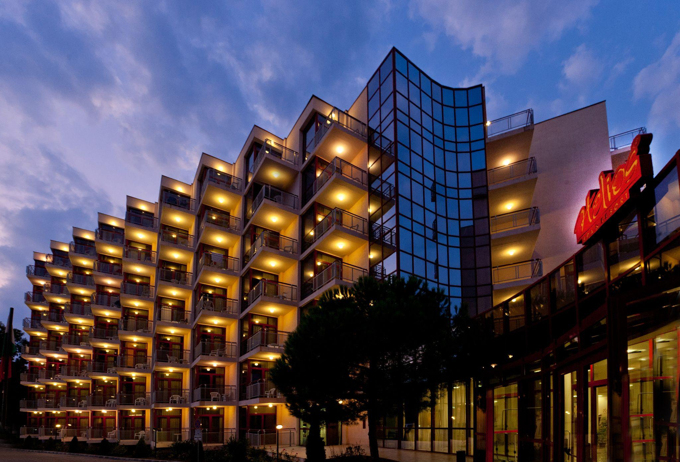
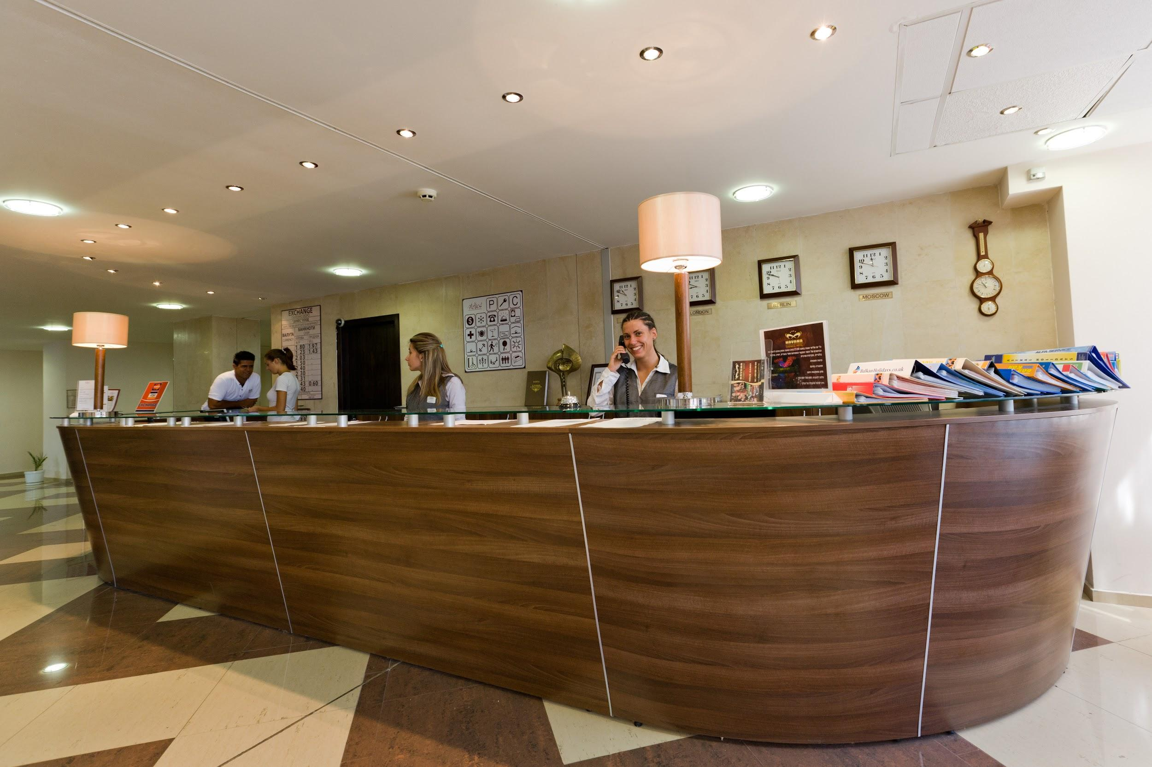
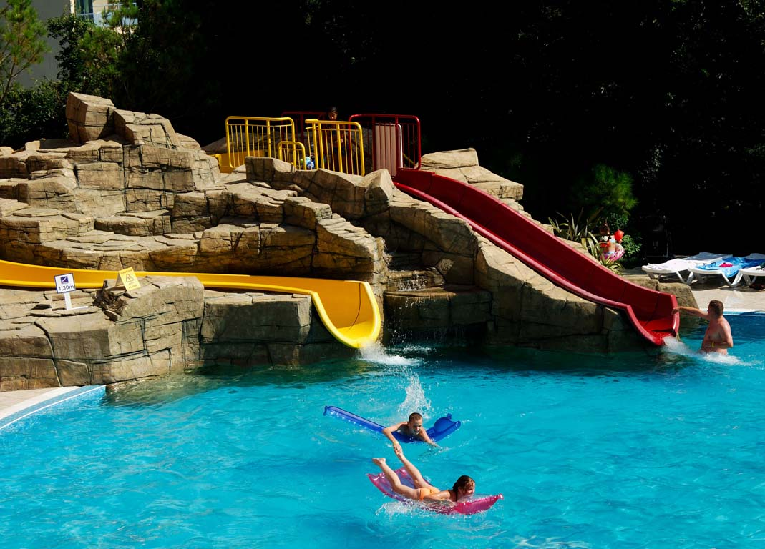
Helios Spa**** All Inclusive
The remarkable architectural complex Helios Spa **** is located in the ancient forest of the Golden Sands Nature Park, overlooking the azure Black Sea. Nearby are the sights Aladzha Monastery, attractive places for shopping in the center of the resort, only 450m away from the beach, as well as the Aquamania Water Park, located 12km away at Albena. Hotel Helios Spa **** is located next to Apollo Spa Resort **** +, and the two hotels share common areas.
Hotel Helios Spa **** has 204 double, family rooms and suites. Every detail brings comfort and sophistication.
Whether you choose a room overlooking the park or the sea, you will be awakened by the silence of the sea breeze, the smell of the forest, the rays of the rising sun. Comfort and coziness in which to create your personal space and get your dream vacation.

Slide 9
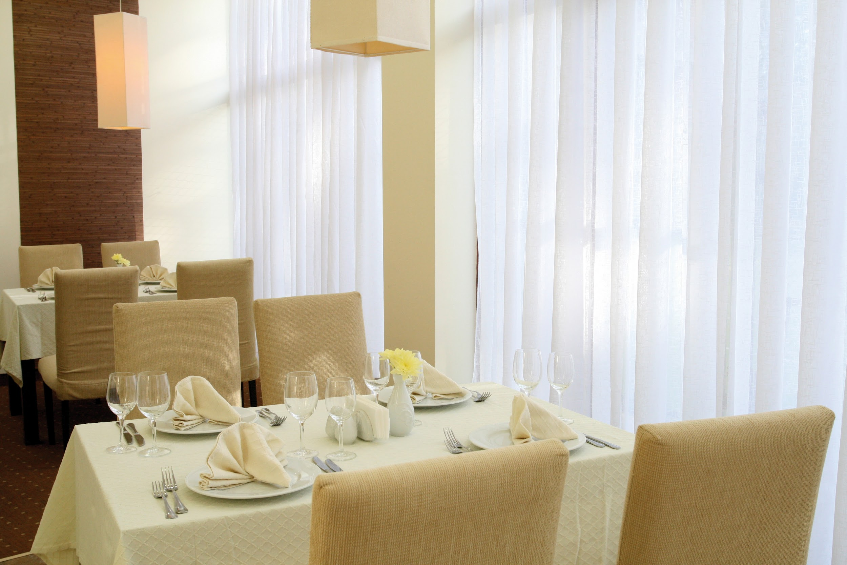
Main Restaurant Helios at Helios Spa Hotel offers guests a unique atmosphere and a wide range of freshly prepared dishes and a special selection of drinks. This modern restaurant serves buffet breakfast, lunch and dinner, as well as snacks and ice cream for All Inclusive guests. Main Restaurant Helios has everything you need for the perfect family or romantic dinner, so that you can turn a simple meal into an extraordinary experience.
Meals available at the hotel are ALL-Inclusive

Slide 10
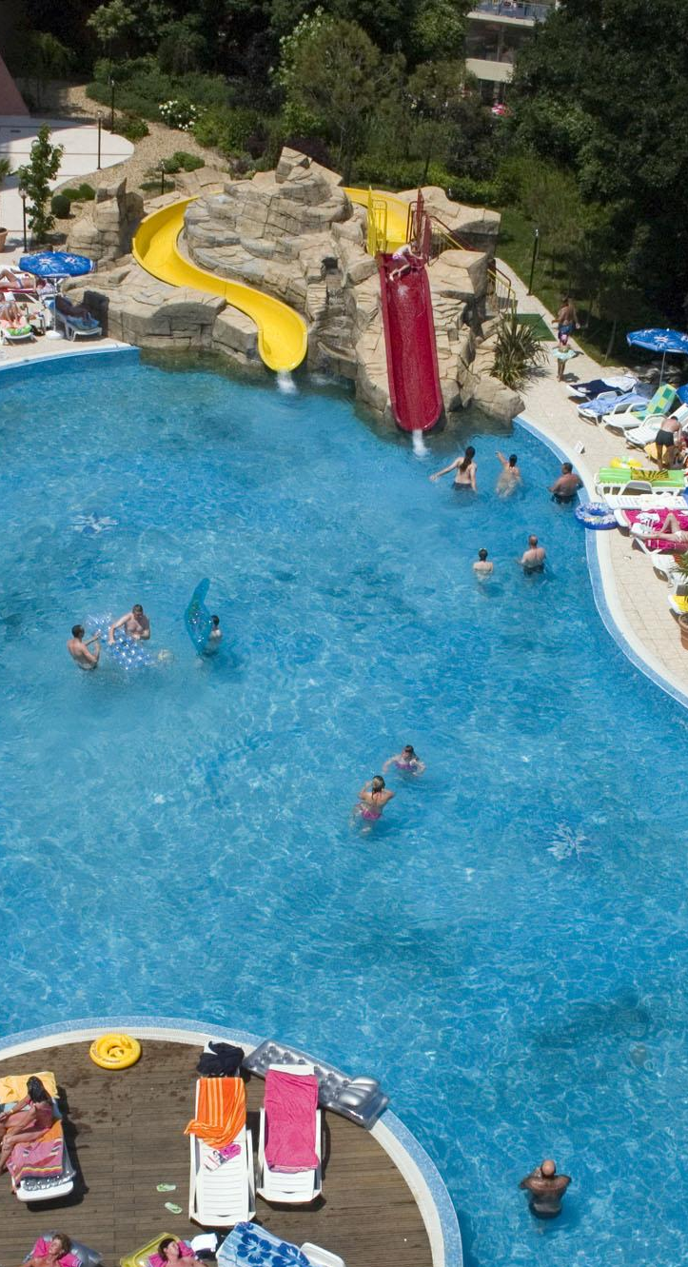
The hotel offers guests a fitness center, two outdoor and one indoor heated pool, as well as a tennis court and a volleyball court with prior request (shared by the Apollo Spa Resort).
For all guests of the hotel Helios Spa ****, who wish to combine their vacation with sports activities, enjoying the fresh sea air, there are: table tennis, fitness, chess, darts, water polo in the pool, water gymnastics , daily sports animation and games, mini football, volleyball, basketball, aerobics, yoga, evening themed parties. For our youngest guests we have provided: animation for children, children's club, playground, outdoor pool with water slide.
The remarkable architectural complex, located in the Black Sea resort of Golden Sands, was completed in 2004.
Hospitality, precision and attention to every detail, the valuable experience of the team and the high standard of the offered services are the basis of the philosophy of Helios Spa ****.

Slide 11
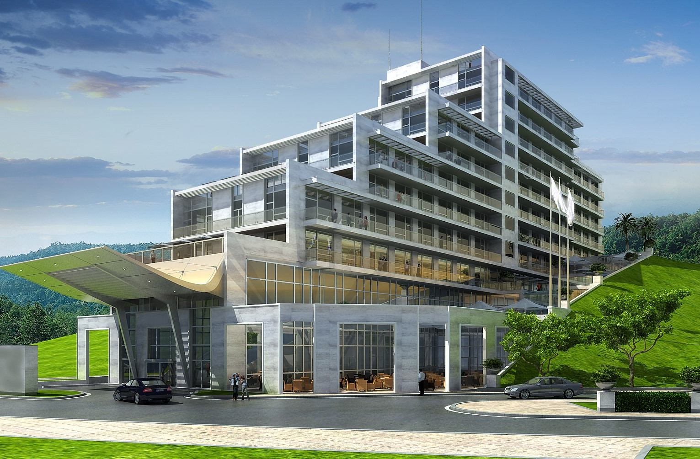
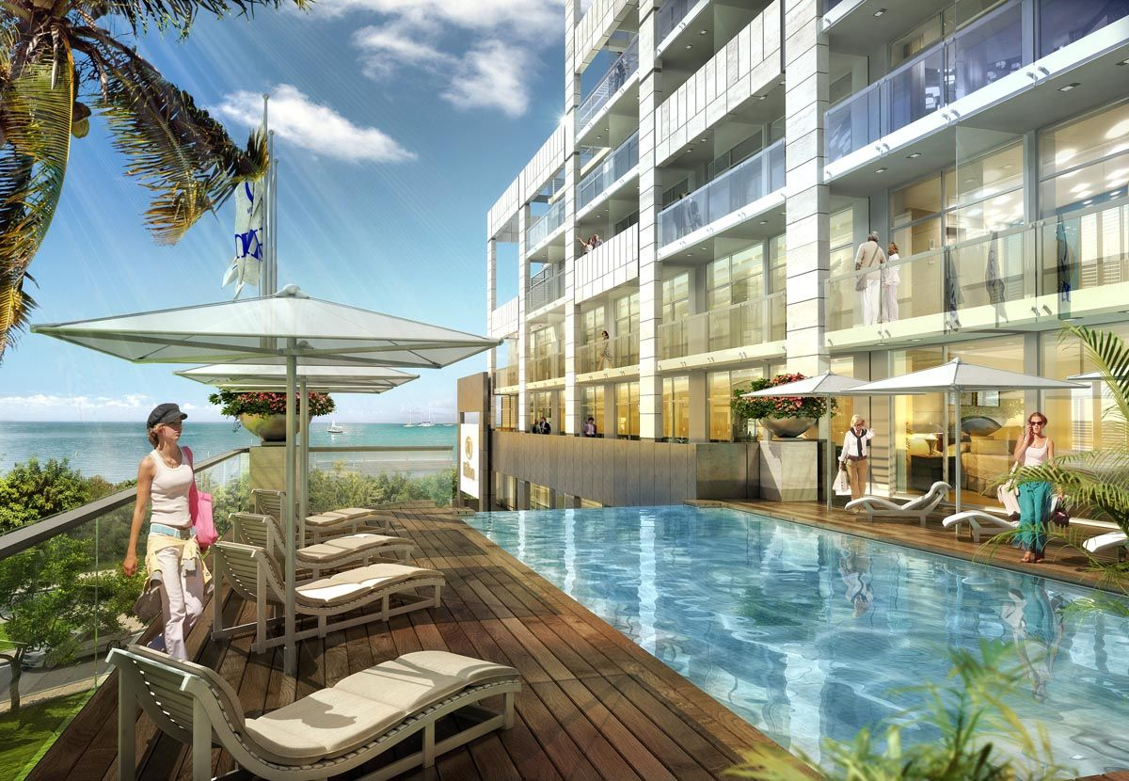
Poseidon Beach Resort *****
Elegant and exclusive, Poseidon Beach Resort ***** is the most luxurious and newest hotel in the Bulgarian Sun Hotels chain, built in 2021.
Contemporary and striking with exquisite classic details, the five-star Poseidon Beach Resort is located in the heart of the resort Golden Sands, with a unique view of the beach.
Near the hotel you can visit Aladzha Monastery, Ancient Odessos, as well as 4 km long sandy beach and shopping area.

Slide 12
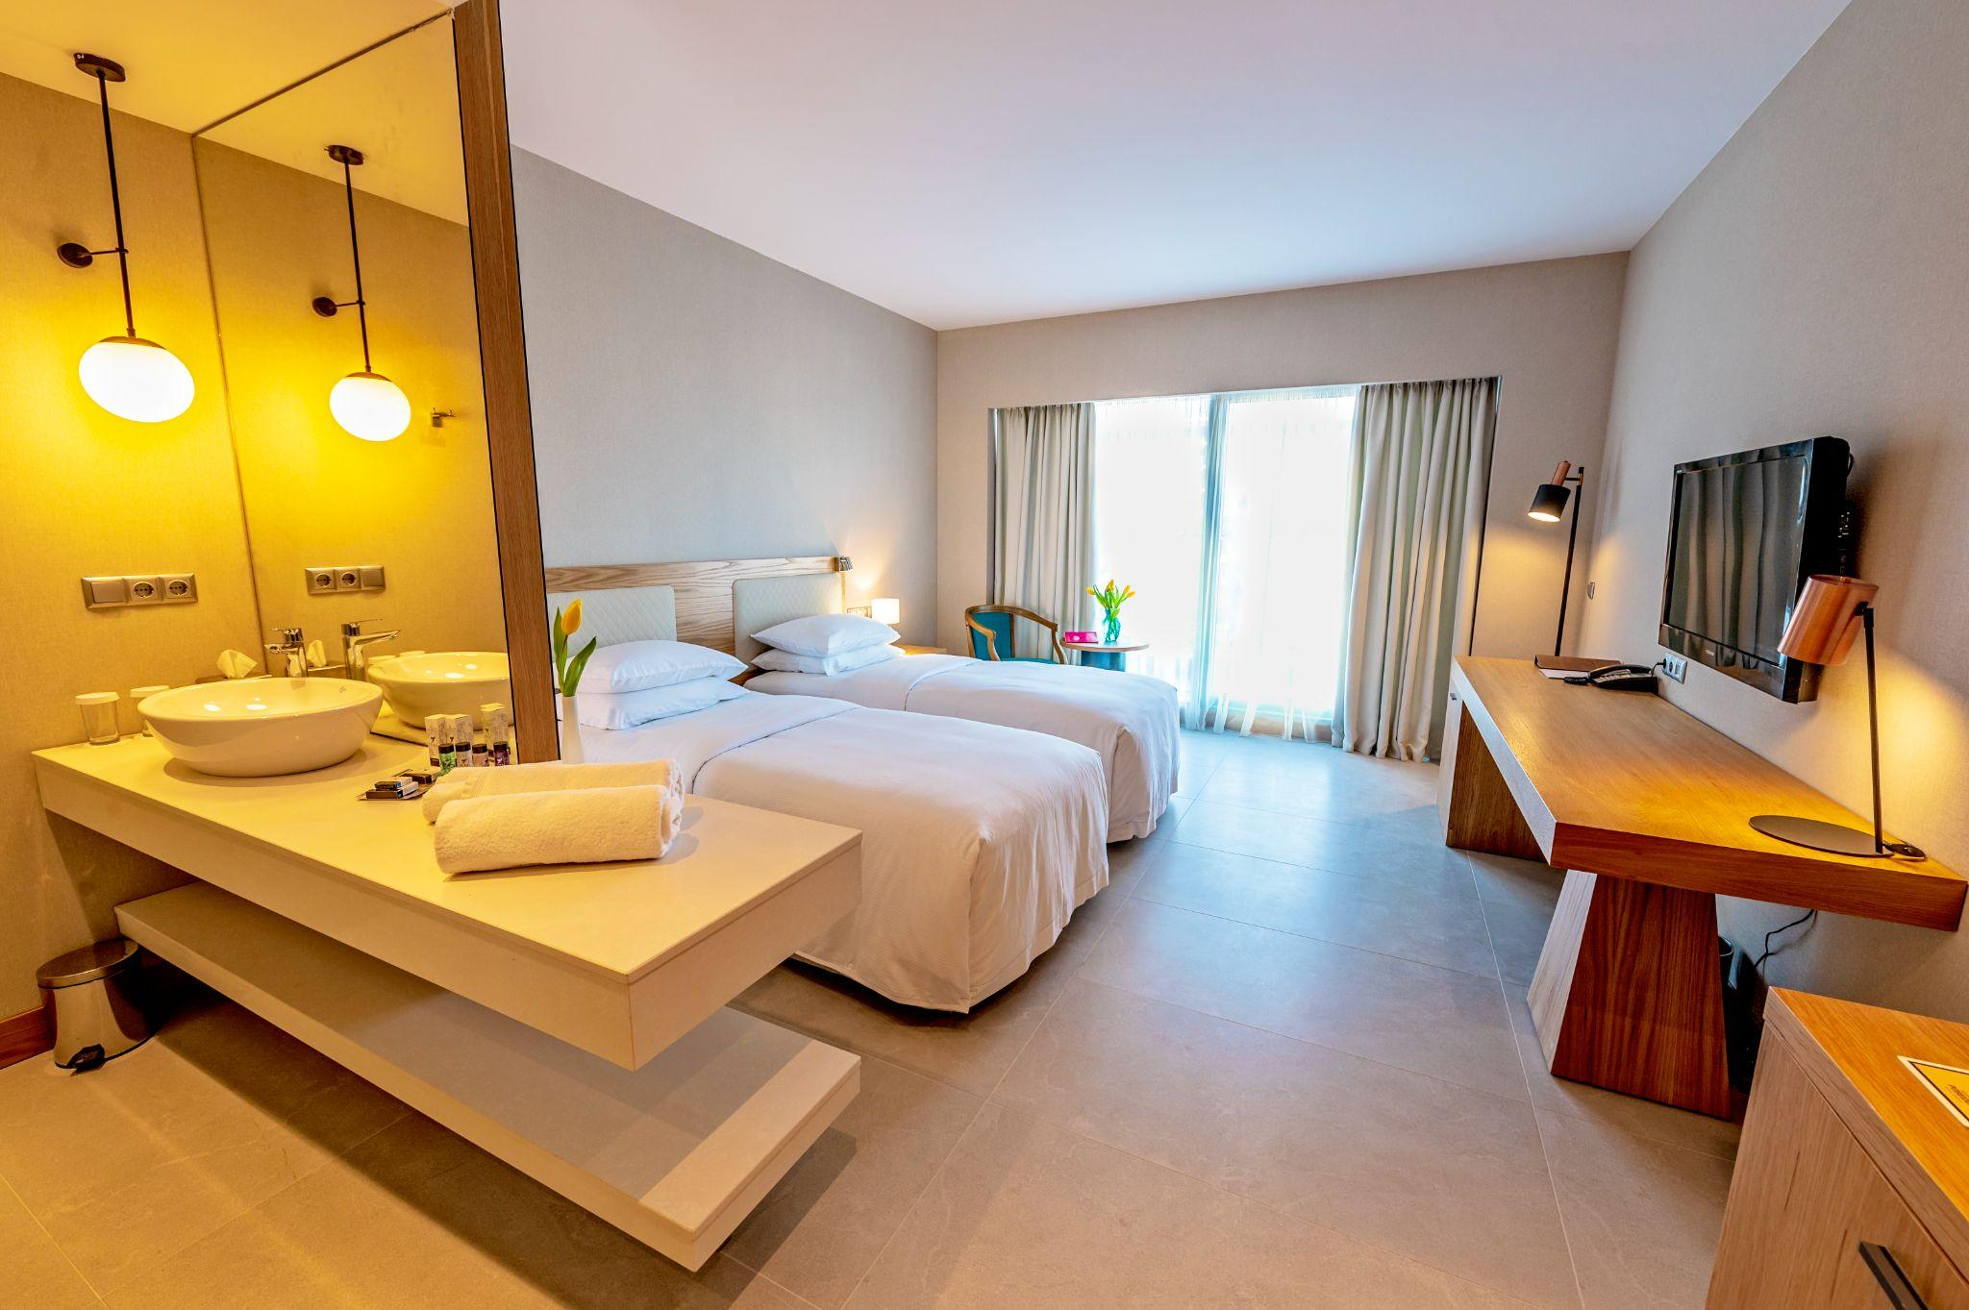
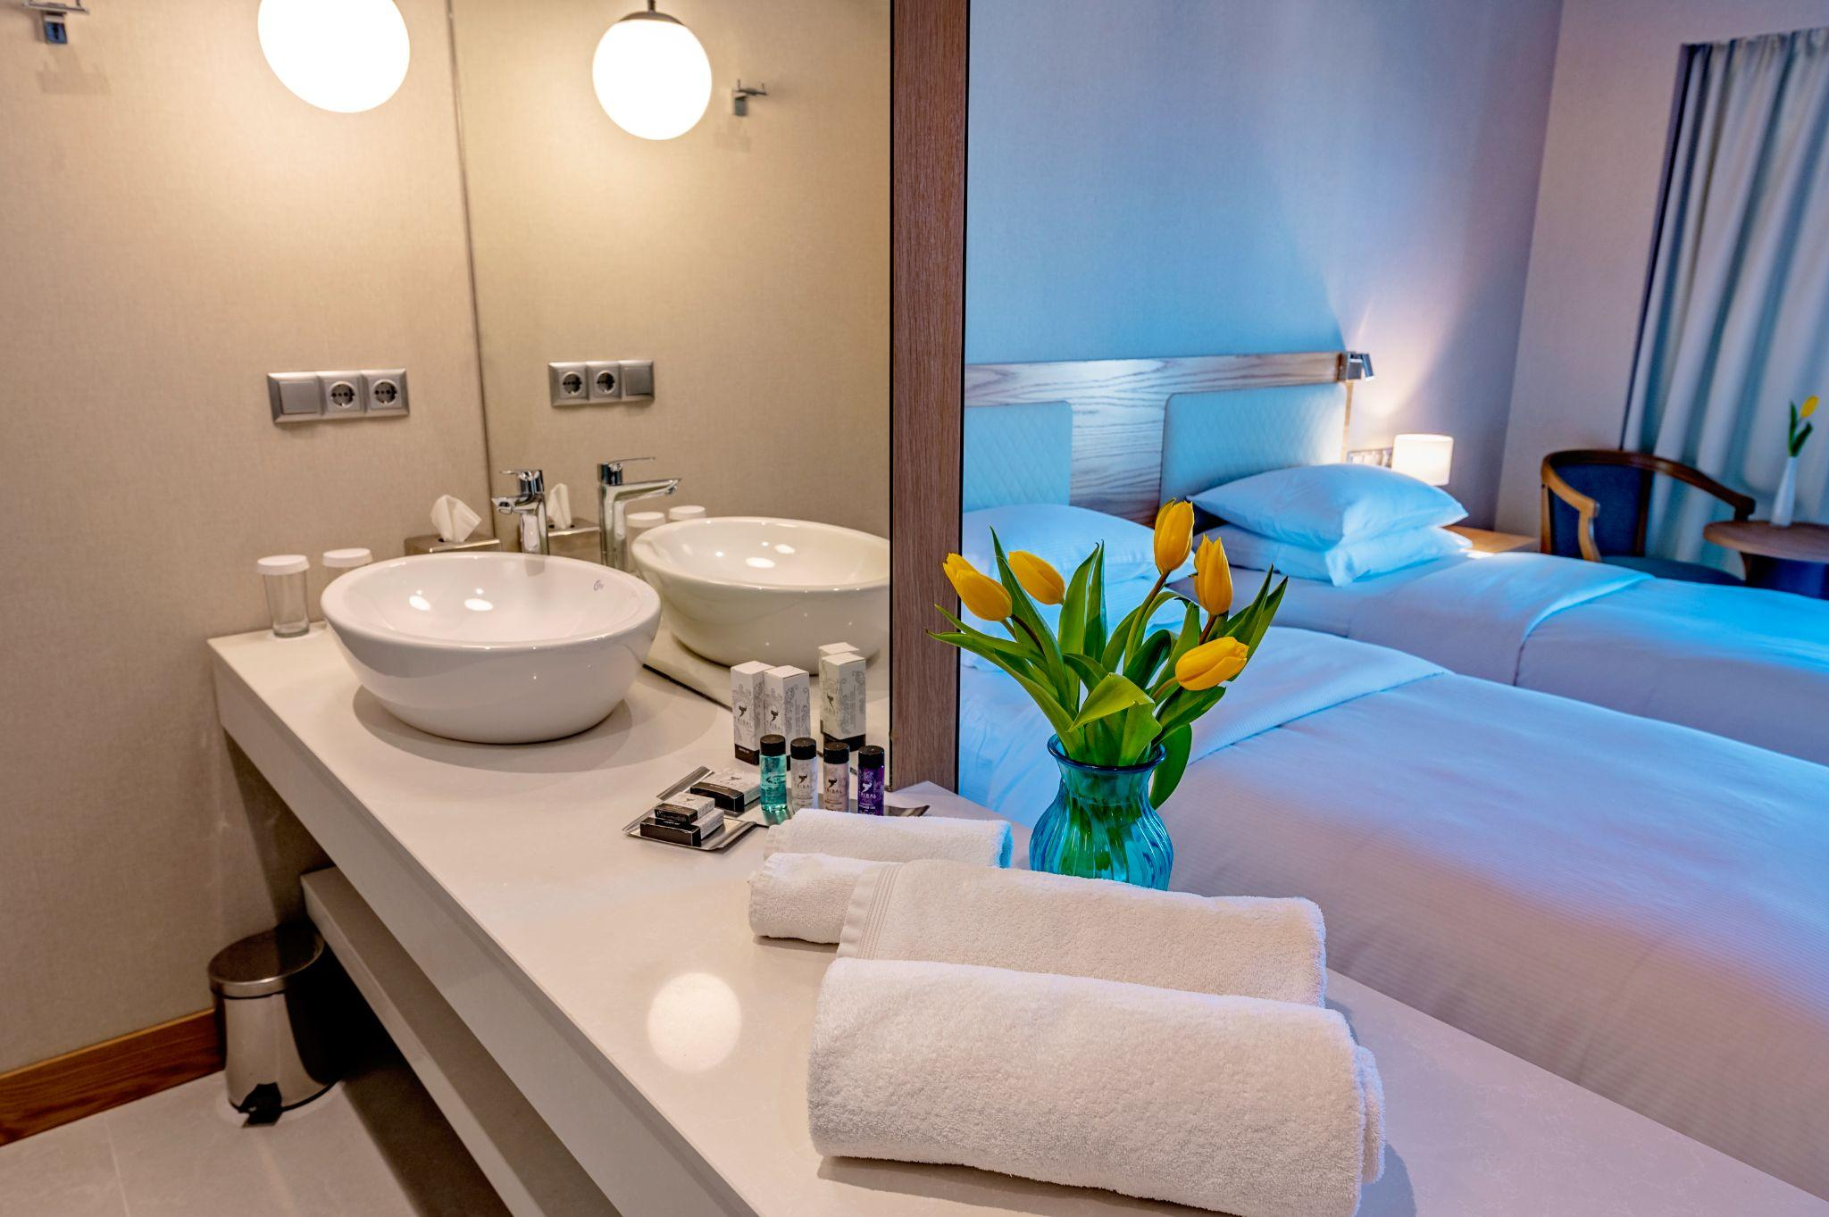
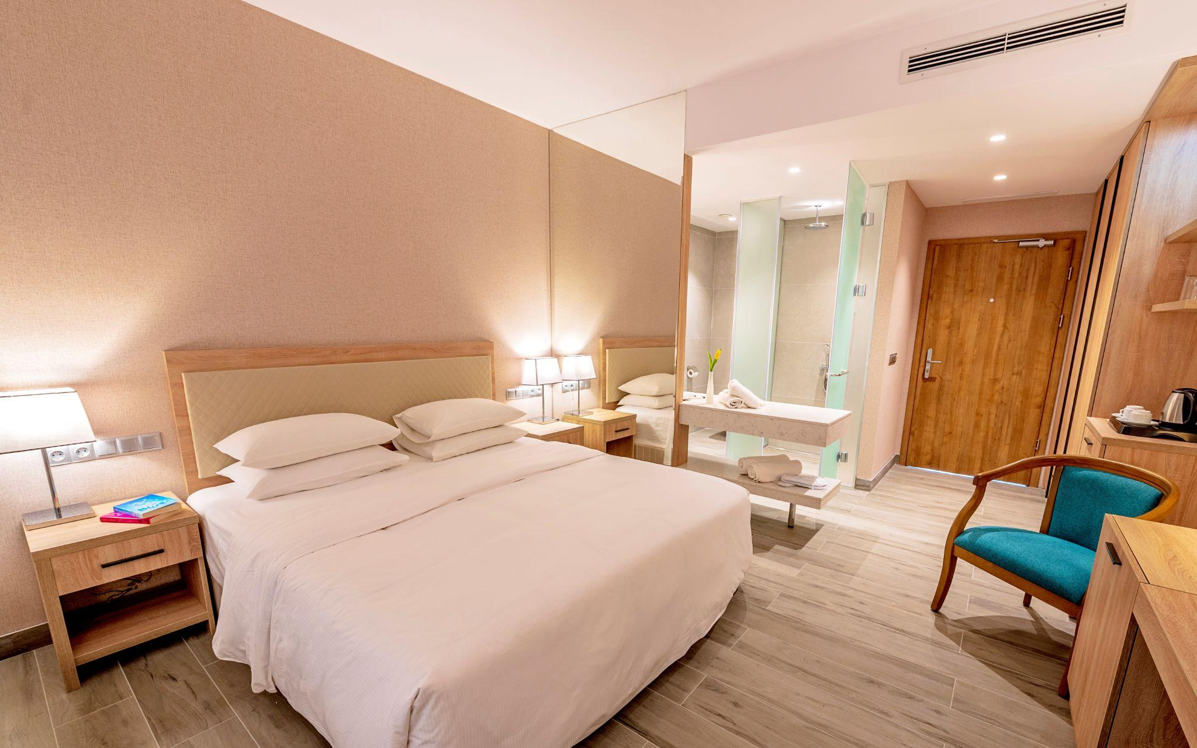
Poseidon Beach Resort ***** has 175 deluxe and superior rooms, spa suits, one bedroom suite and presidential suite. The hotel also offers conference facilities capable of accommodating up to 600 delegates simultaneously.
Whether for a family vacation, honeymoon, wedding ceremony, conference or just a relaxing holiday, Poseidon Beach Hotel in Golden Sands is a luxury destination for everyone.
The hotel has a private beach and guests can take advantage of specially preserved parasols and sun loungers, or enjoy sunbathing by the infinity pool.

Slide 13
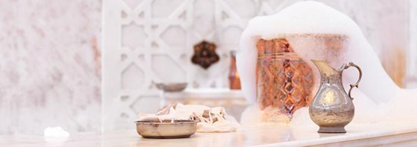
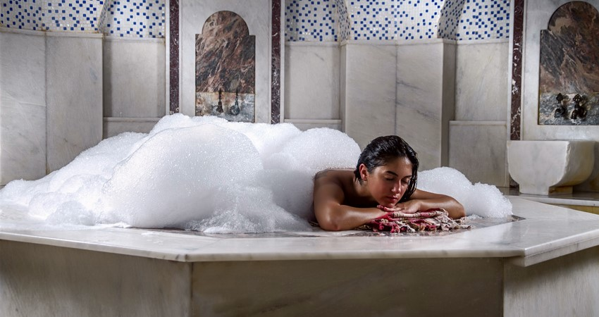
Younger guests can take advantage of the kids ’club, which offers a variety of indoor and outdoor activities, including babysitting services, leaving parents to relax in the boutique spa with a modern glass-walled gym and views of the infinity pool, the cascading waterfall and lush forest of Golden Sands Nature Park.
The spa is located in front of a luxurious outdoor swimming infinity pool - a paradise for tranquility and complete relaxation.
Highly qualified therapists take care to rejuvenate the mind, body and spirit of the guests of Poseidon Beach Resort ***** with a unique concept of hammam treatment, which combines traditional therapies from Europe and the Far East.

Slide 14
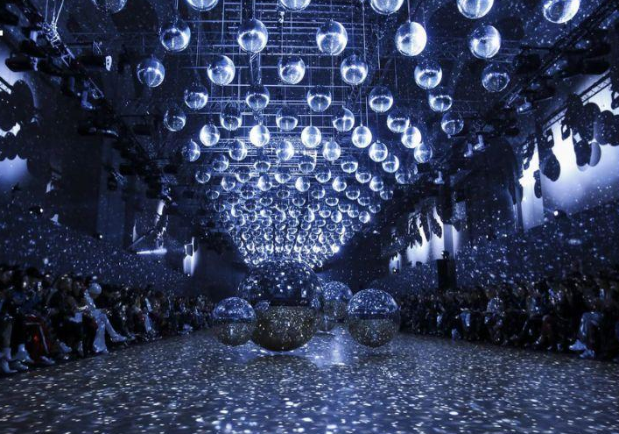
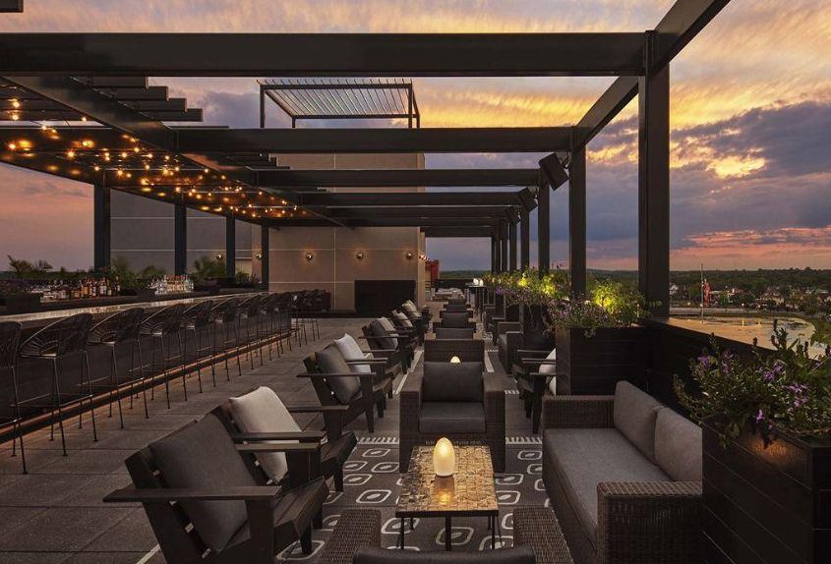
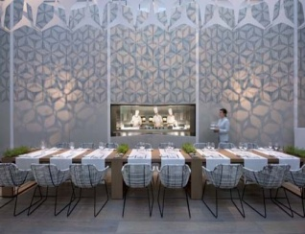
Poseidon Beach Resort ***** is a leader among the hotels on the Bulgarian Black Sea coast in terms of food.
The five specialized restaurants offer the most exquisite cuisine from around the world, kosher menu and halal menu prepared by amazing international chefs who make Poseidon Beach Resort ***** - a TOP destination for true connoisseurs of food and leisure.
If you add to all this the restored legendary karaoke bar and club "Golden Sands" and a boutique spa with infinity pool, you will be enchanted to see how diversity and luxury merge into one.

Slide 15
#YourSecondHome

