Slide 1
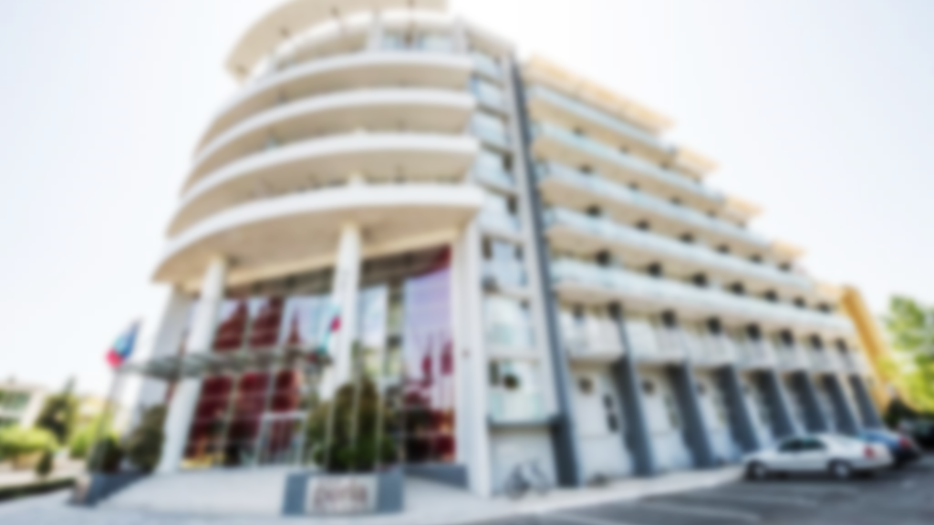
NEW HOTEL PERLA
OPENING SUMMER 2023

Slide 2
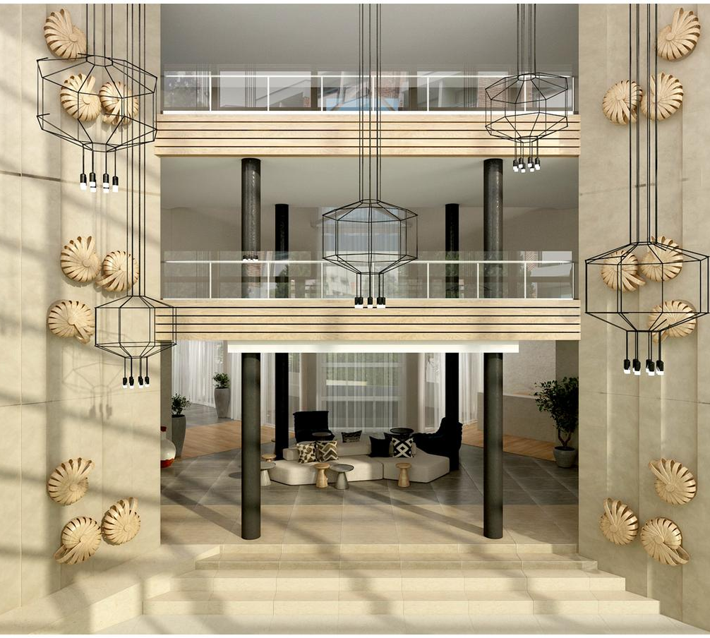
WELCOME TO
HOTEL PERLA
RENOVATED FROM THE BOTTOM TO THE TOP WE PRESENT YOU THE NEW VISION OF HOTEL PERLA.

Slide 3
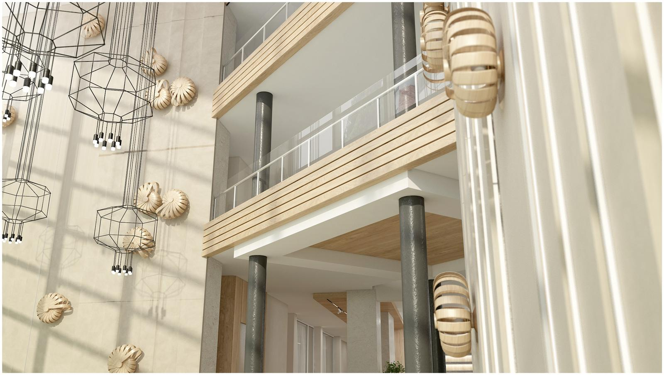

Slide 4
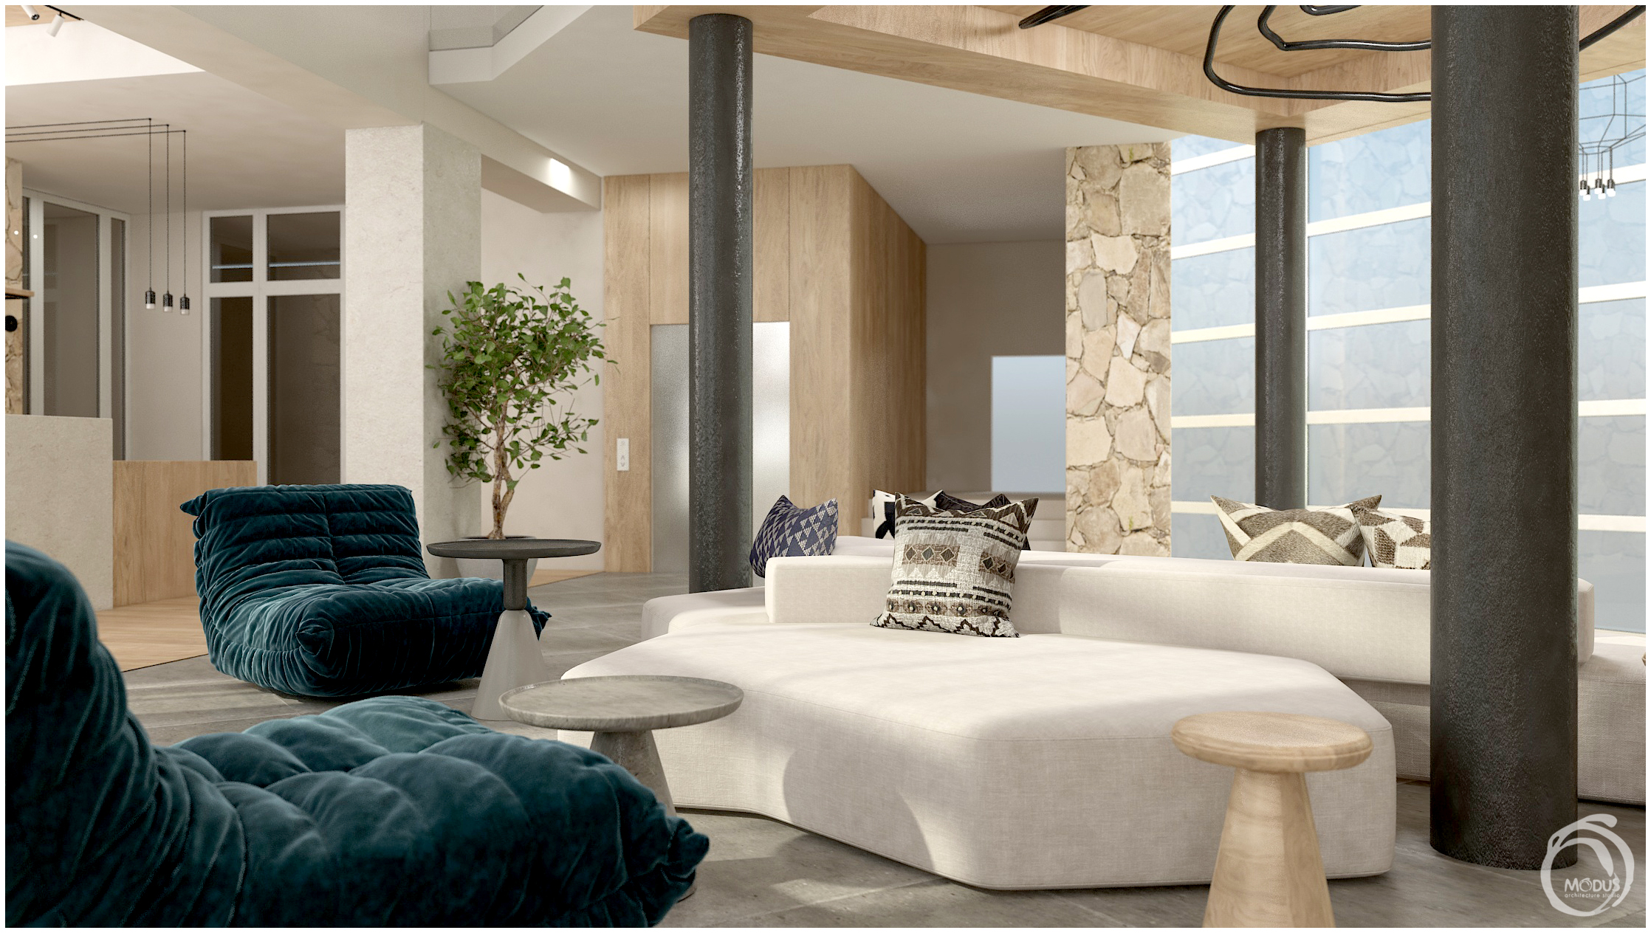
OUR CONCEPT RECEPTION
RECEPTION IS THE FIRST AND LAST PLACE A TOURIST VISITS, A COMFORATBLE AND MODERN PLACE.

Slide 5
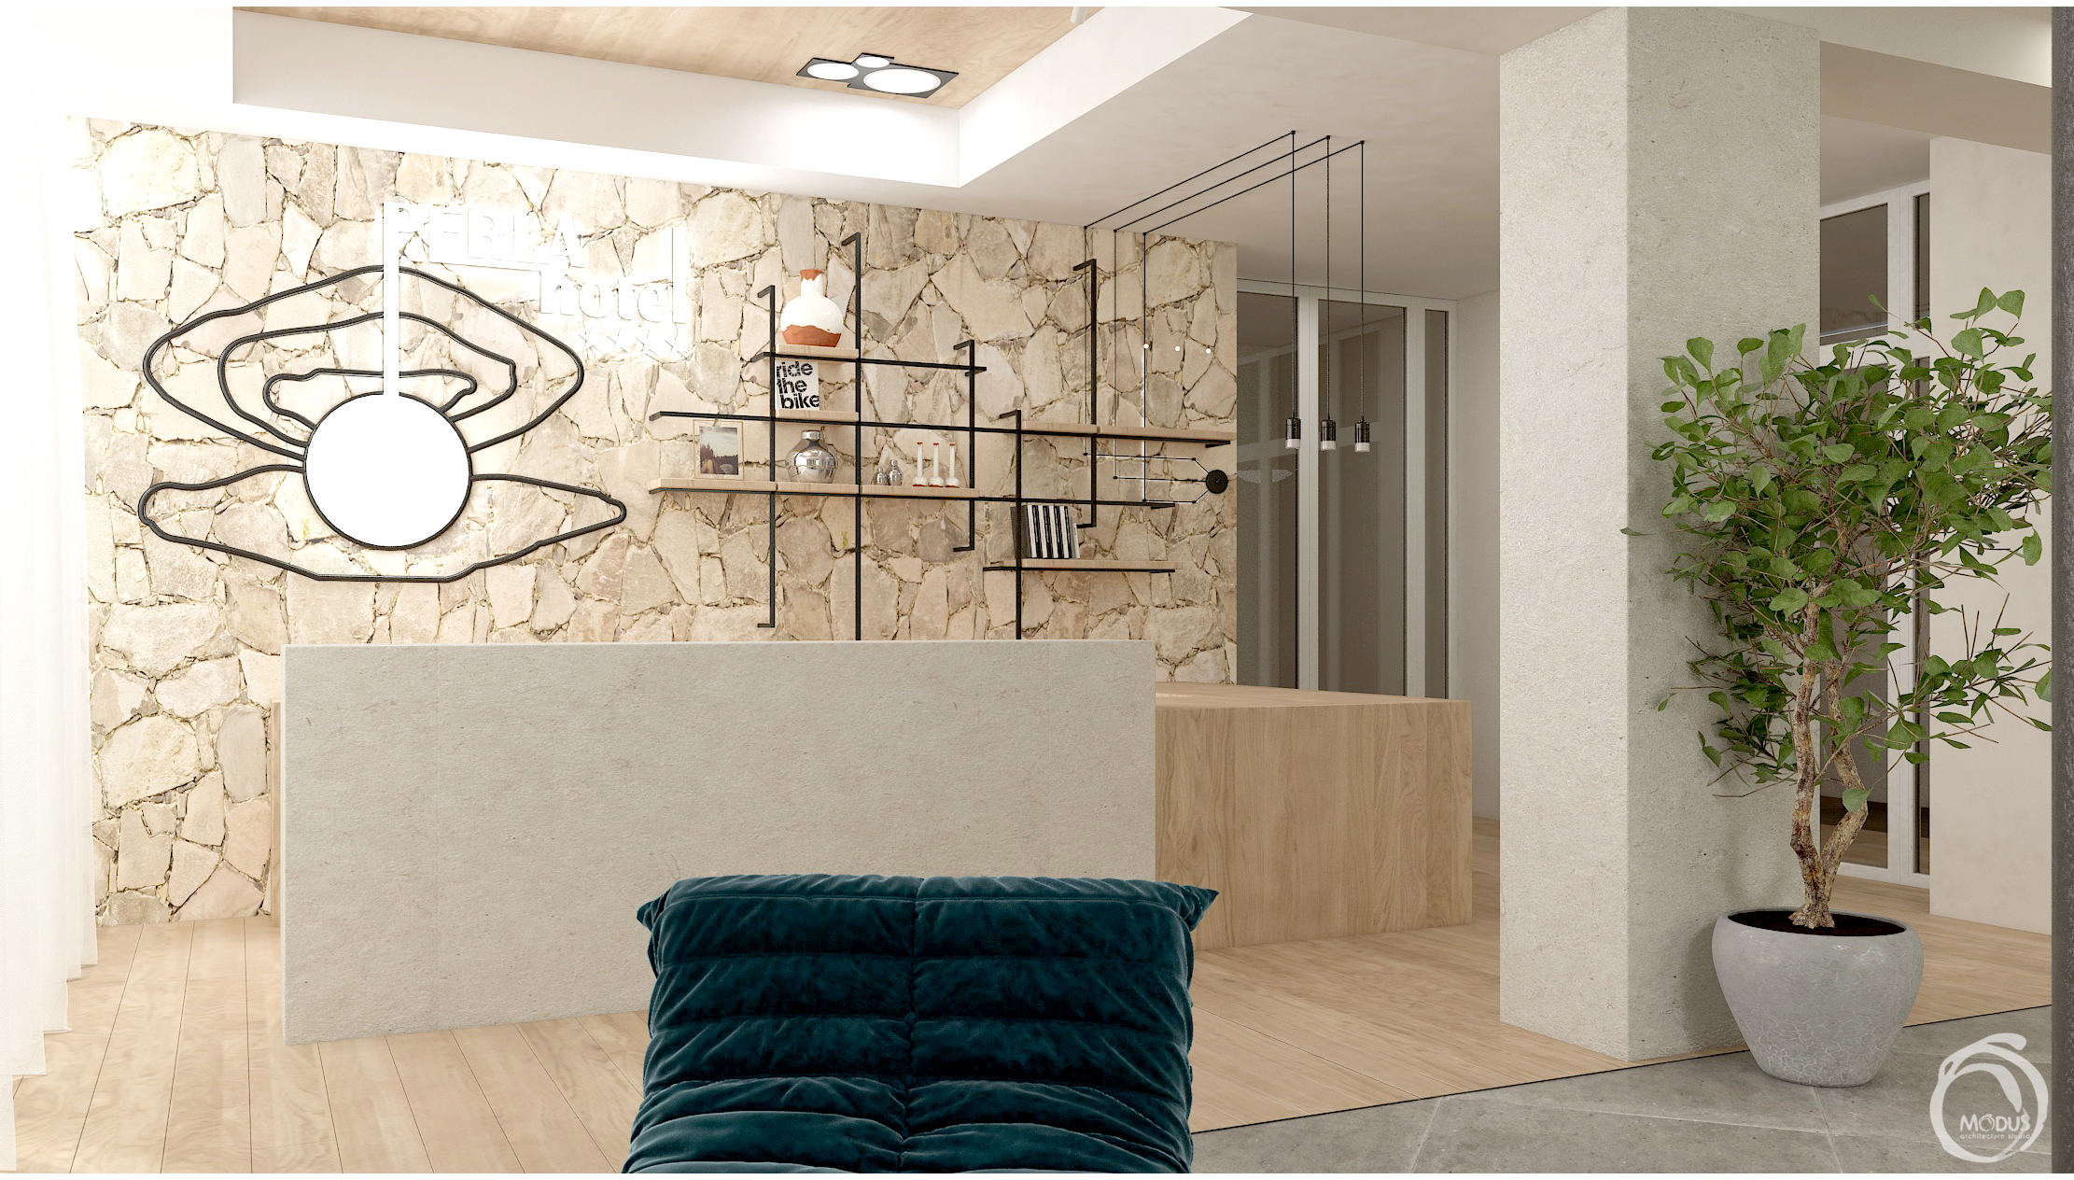

Slide 6
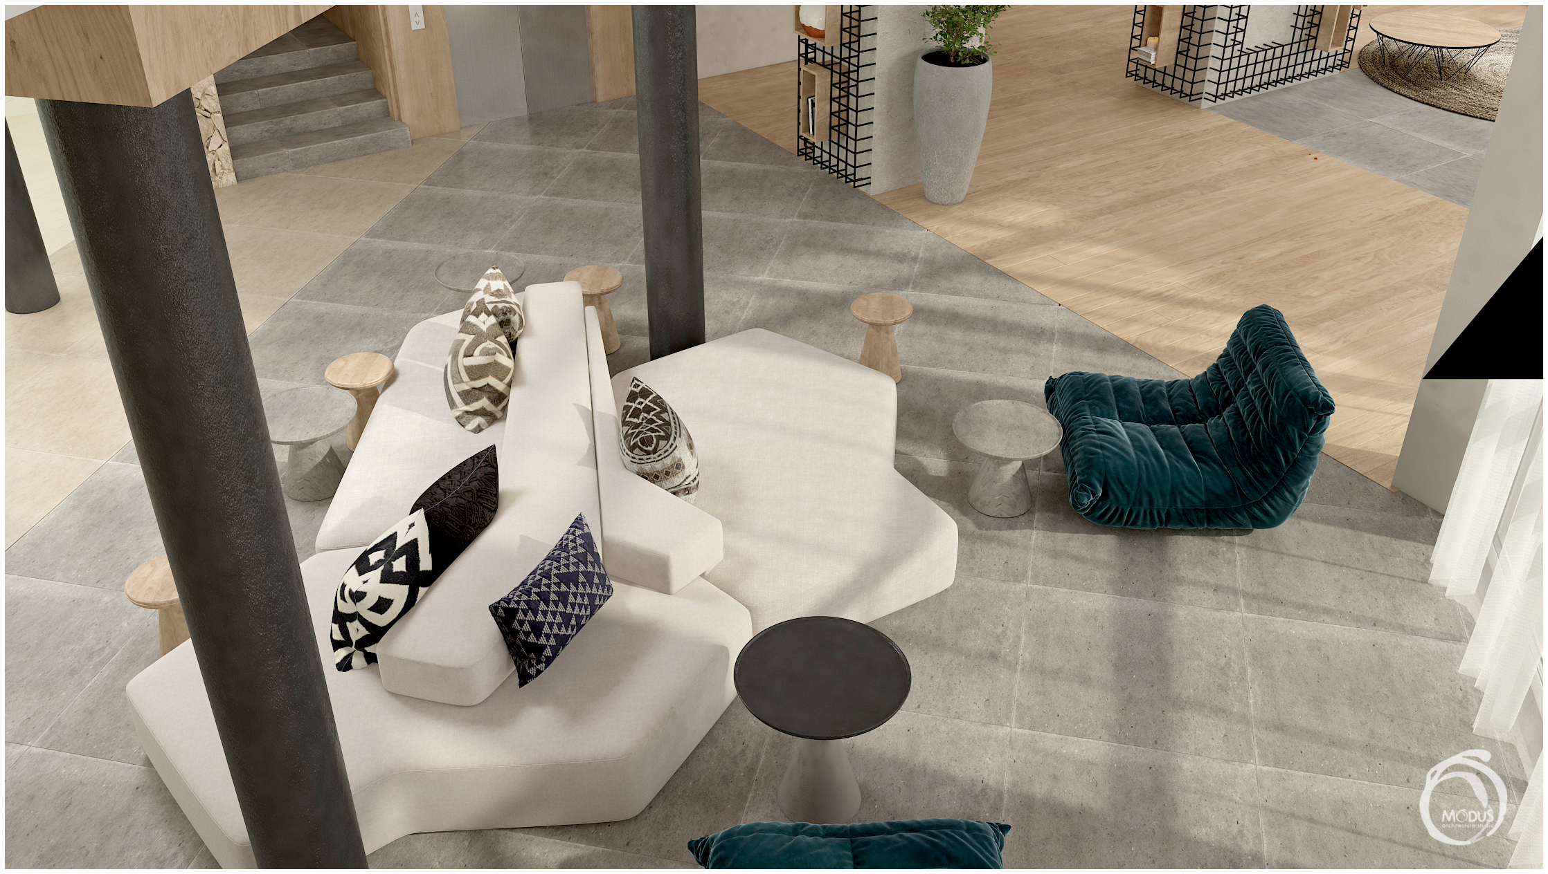

Slide 7
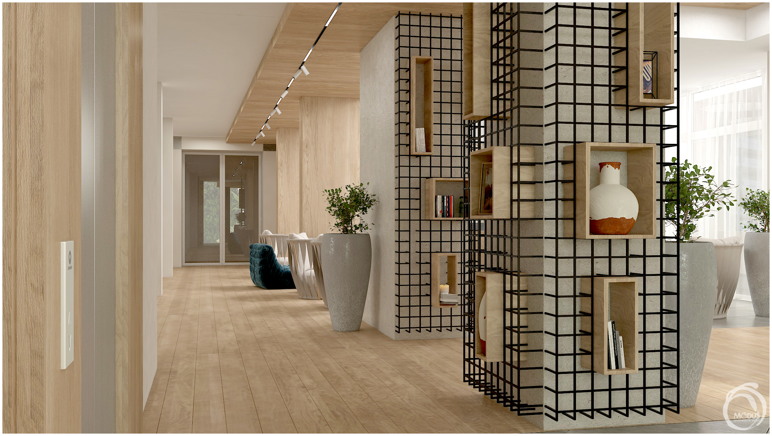
OUR CONCEPT
LOBBY BAR
LOBBY BAR IS DESIGNED AS A ENJOYABLE AND STYLISH AREA TO HAVE FUN OR GET SOME WORK DONE

Slide 8
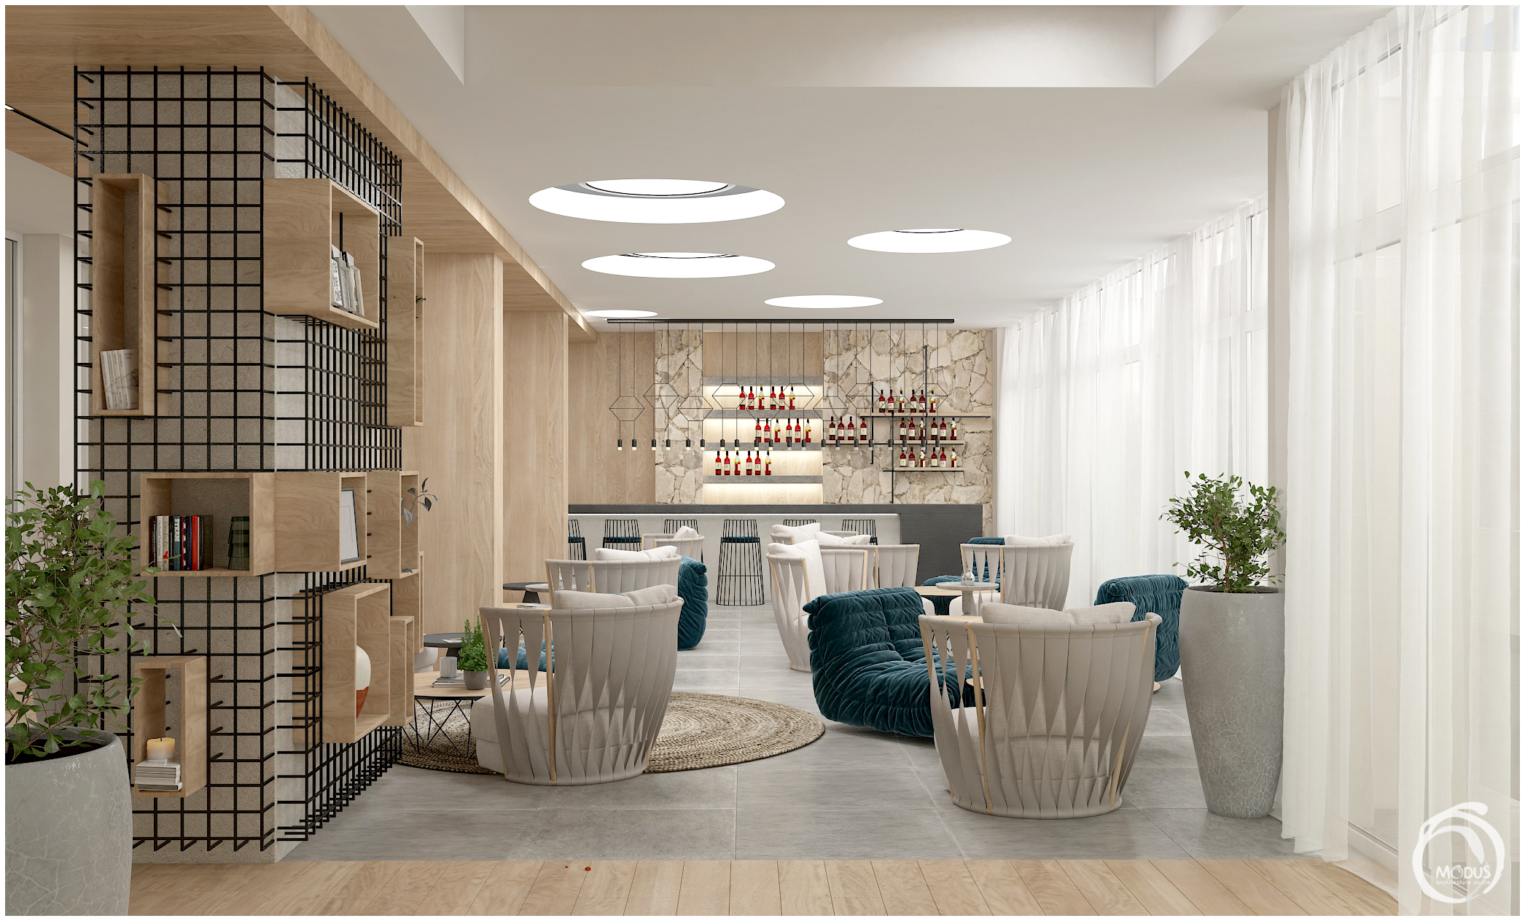

Slide 9
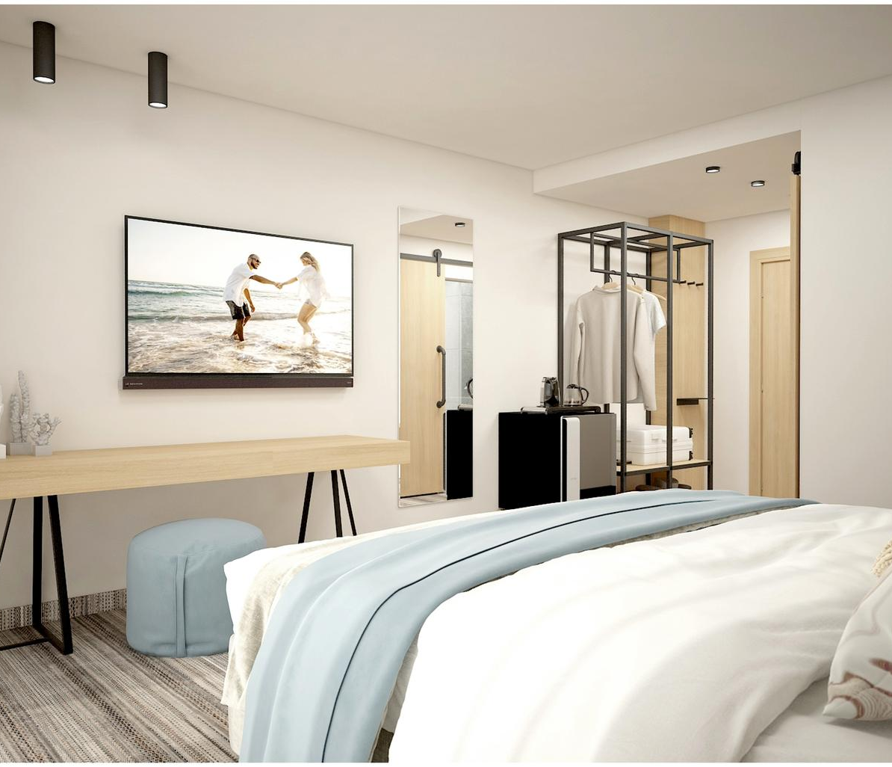
OUR CONCEPT
ROOMS
THE IDEAL COMFORATBLE PLACE TO RELAX AND FEEL AT HOME

Slide 10
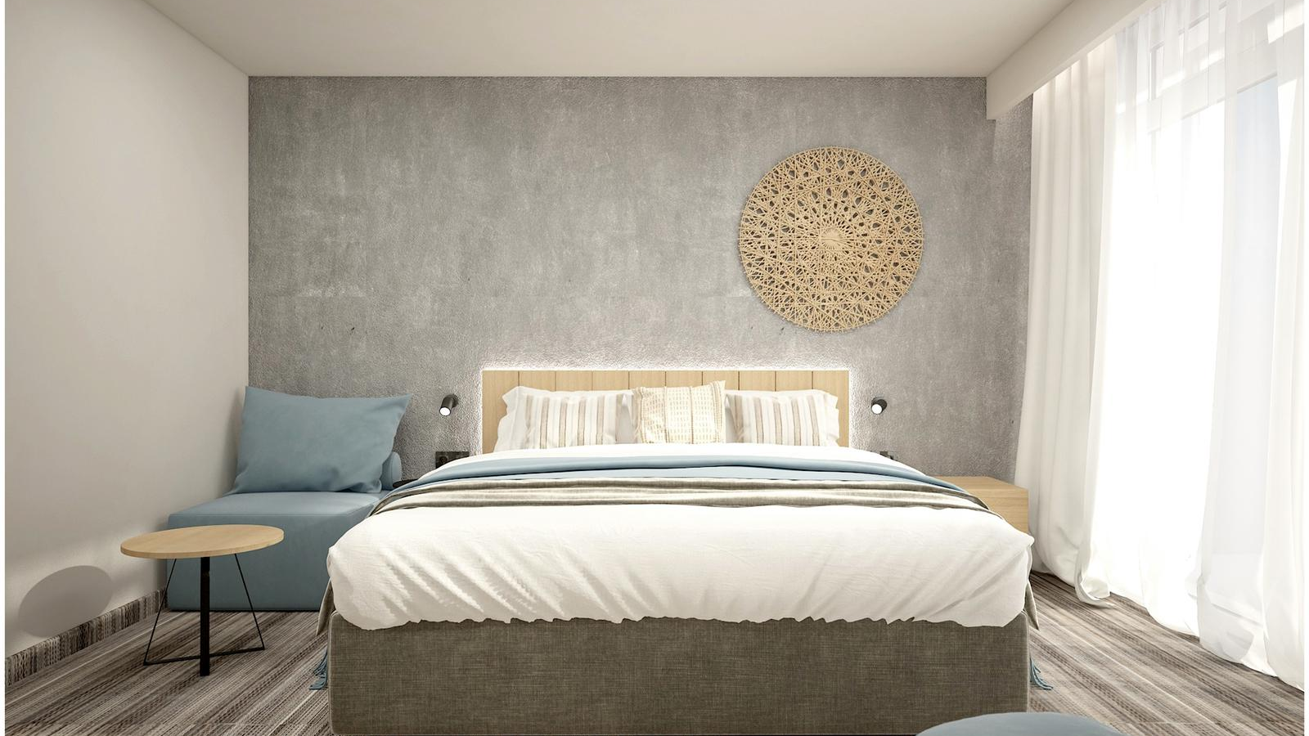

Slide 11
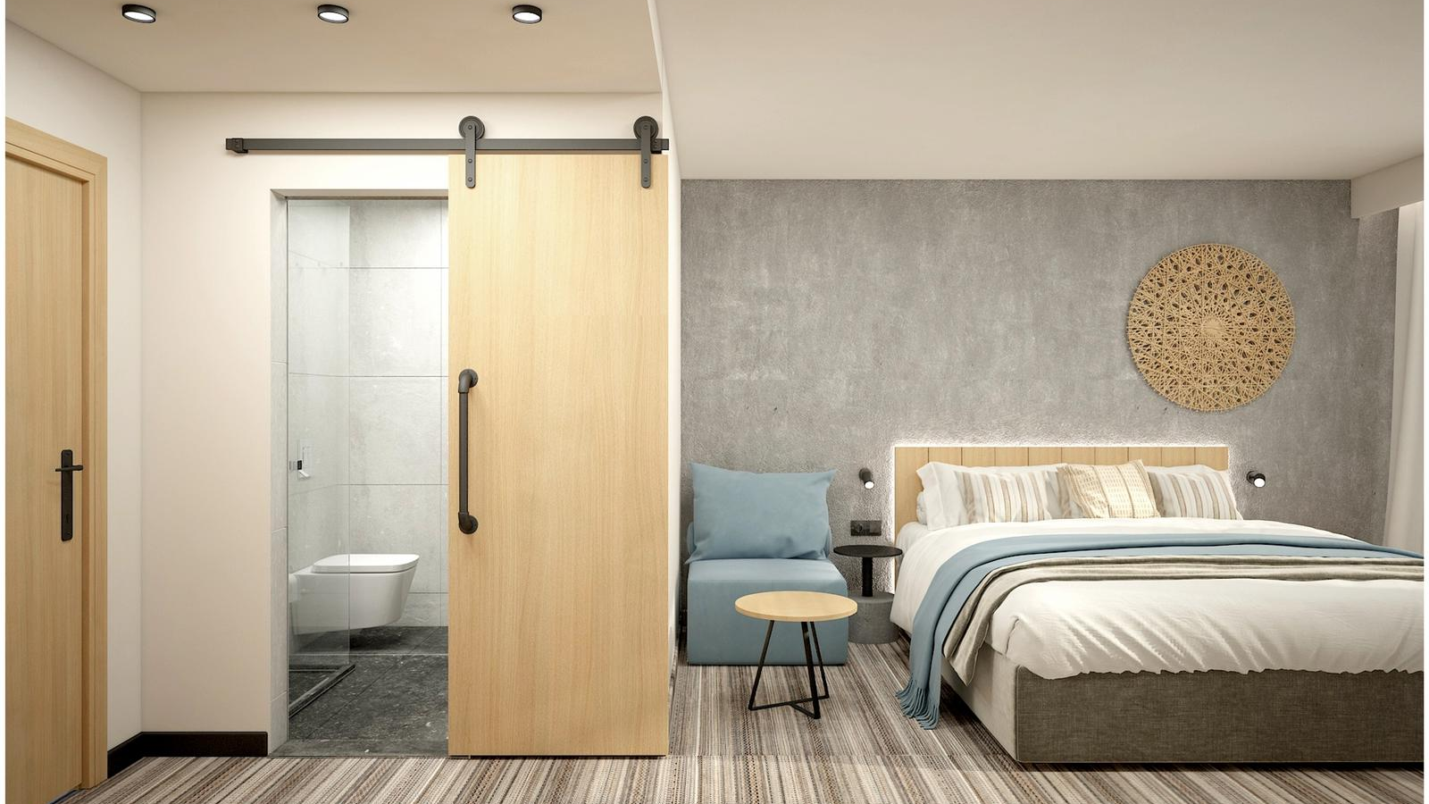

Slide 12
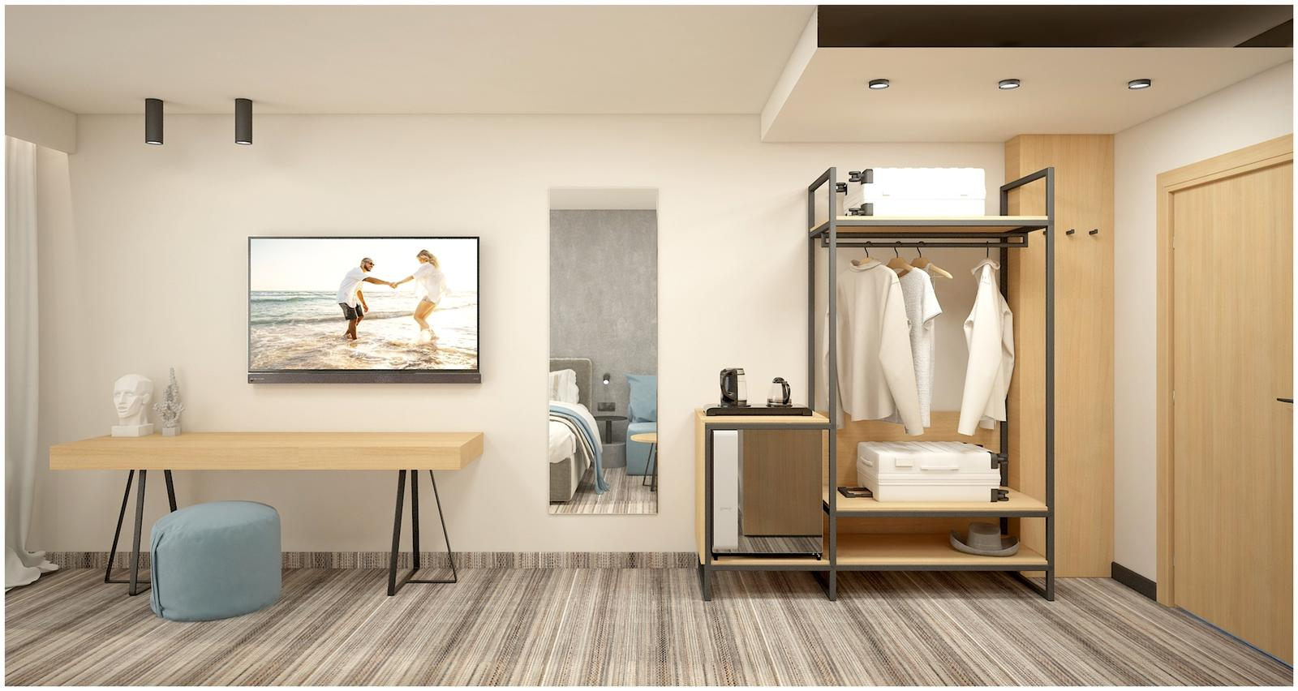

Slide 13
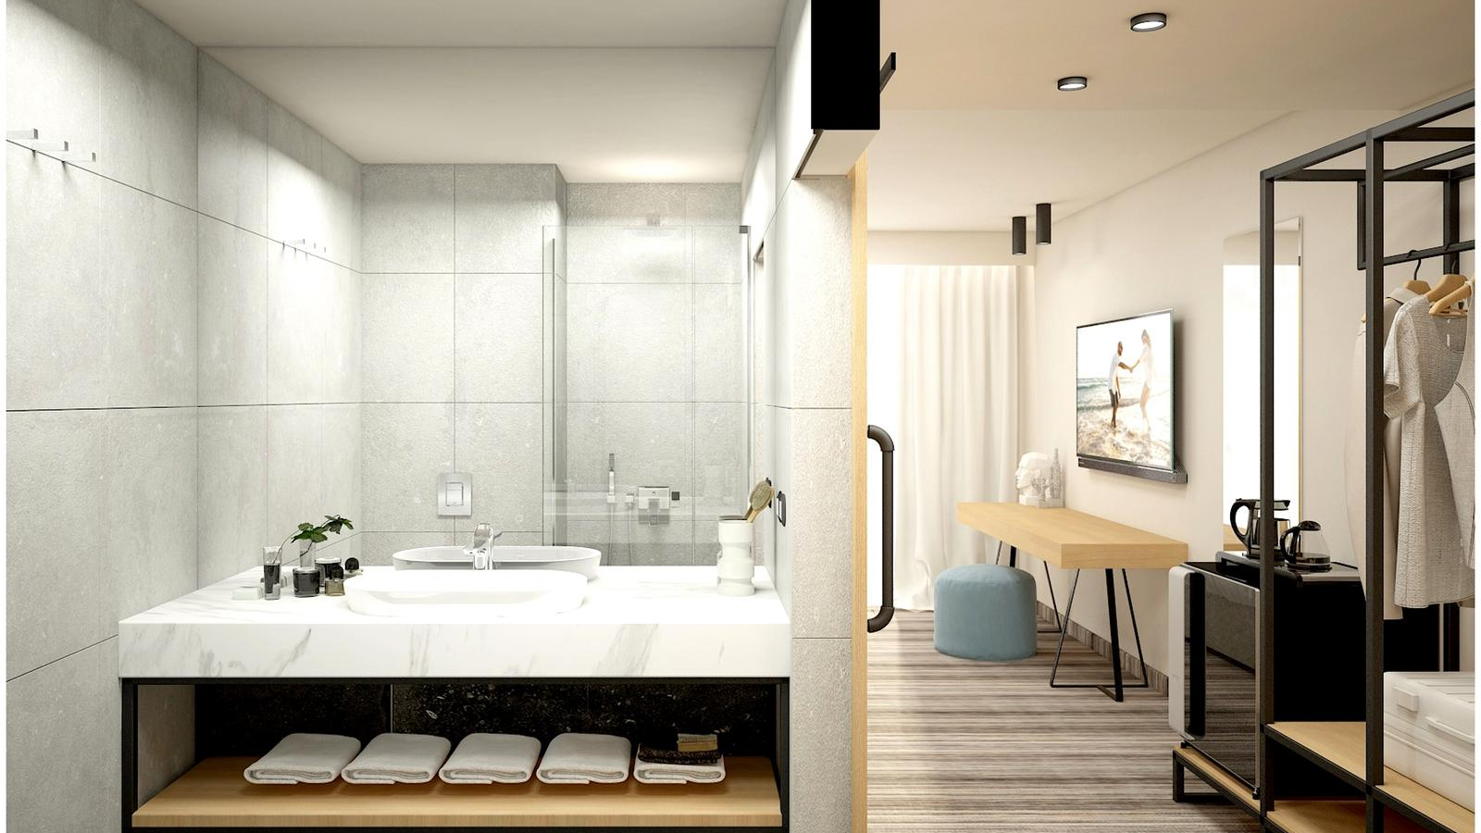

Slide 14
ABOUT HOTEL PERLA
Modernised in 2022, fully renovated four-star hotel complex "Perla" is located in the northern part of the resort of Sunny Beach, 250 meters from the beach and 300 meters from the center of the complex. It is located on the main street, meters away from the bus stop and with convenient transport connection to Burgas Airport, which is at a distance of 30 km, 25 minutes away from the hotel.
There are a total of 140 rooms at the disposal of the guests of the hotel "Perla" - 122 double rooms, 6 studios and 12 apartments, one of which is VIP. The rooms are a variety of elegant style, comfort and functionality - air-conditioned, cozy and comfortable, equipped with telephone, TV, mini-bar, balcony.

Slide 15
ABOUT THE EXPERIENCE
The hotel operates an all-inclusive program, with the option of bed and breakfast.
The stylishly furnished restaurant offers breakfast, lunch, afternoon snacks and dinner, with a wide range of healthy dishes - salads, appetizers, vegetarian dishes, seafood, fruits and desserts, juices, a selection of local wines, beer, soft drinks and more.
The lobby bar is a wonderful place for a refreshing drink on hot summer days, as well as for meetings in a pleasant and relaxed atmosphere.
Guests can also use a safe at the reception, payed parking, free WI-FI, hairdresser, a conference hall with conference equipment and Internet access, with a capacity of 50 seats for conferences, seminars, business meetings, corporate events.

Slide 16
POOL & GARDEN AREA
Introducing our garden, where in addition to the pool with comfortable sun beds, we will take care of the relaxation and entertainment of our guests in the animated "event ring".
The "event ring" is a place for entertainment for young and old - animation for children, theme nights and shows. Animators entertain the youngest guests with interesting, creative and entertaining games. And for the older ones we have thought with an outside bar for more entertaining evening shows.
Relaxation, sport and mood is also created by the outdoor swimming pool and our fitness room which beautifully complements a relaxing holiday.

Slide 17
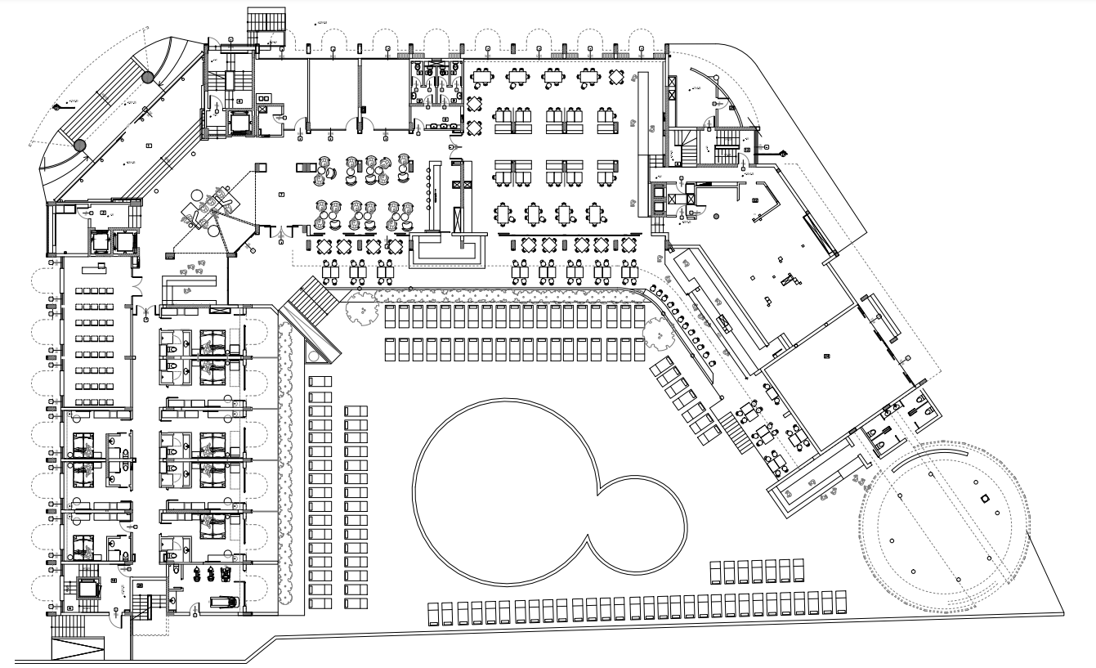

Slide 18
